Slide 1
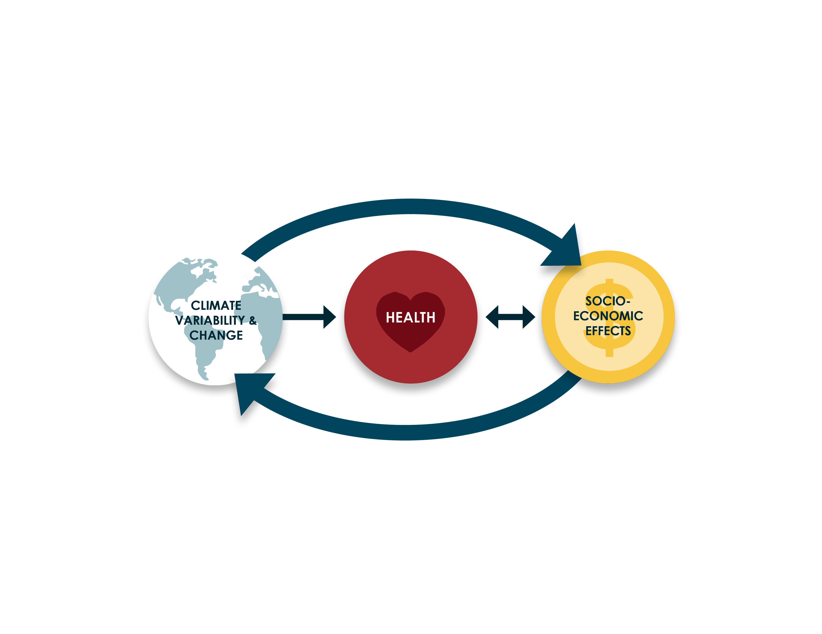
Figure 1.1 Direct and indirect interactions between climate and health – in part mediated by socio-economic effects.
Madeleine C. Thomson, Tamer Samer Rabie, Joy Shumake-Guillemot, John McDermott, Wilmot James and Chadia Wannous (2019) Chapter 1: Health priorities, and emerging policy congruence in the Sustainable Development Goals. In “Climate Information for Public Health Action”, Eds. Thomson, M.C. & Mason, S.J. Routledge, London, UK
Notes:
Figure 1.1 Direct and indirect interactions between climate and health – in part
mediated by socio-economic effects.
Madeleine C. Thomson, Tamer Samer Rabie, Joy Shumake-Guillemot, John McDermott, Wilmot James and Chadia Wannous (2019) Chapter 1: Health priorities, and emerging policy congruence in the Sustainable Development Goals. In “Climate Information for Public Health Action”, Eds. Thomson, M.C. & Mason, S.J. Routledge, London, UK

Slide 2
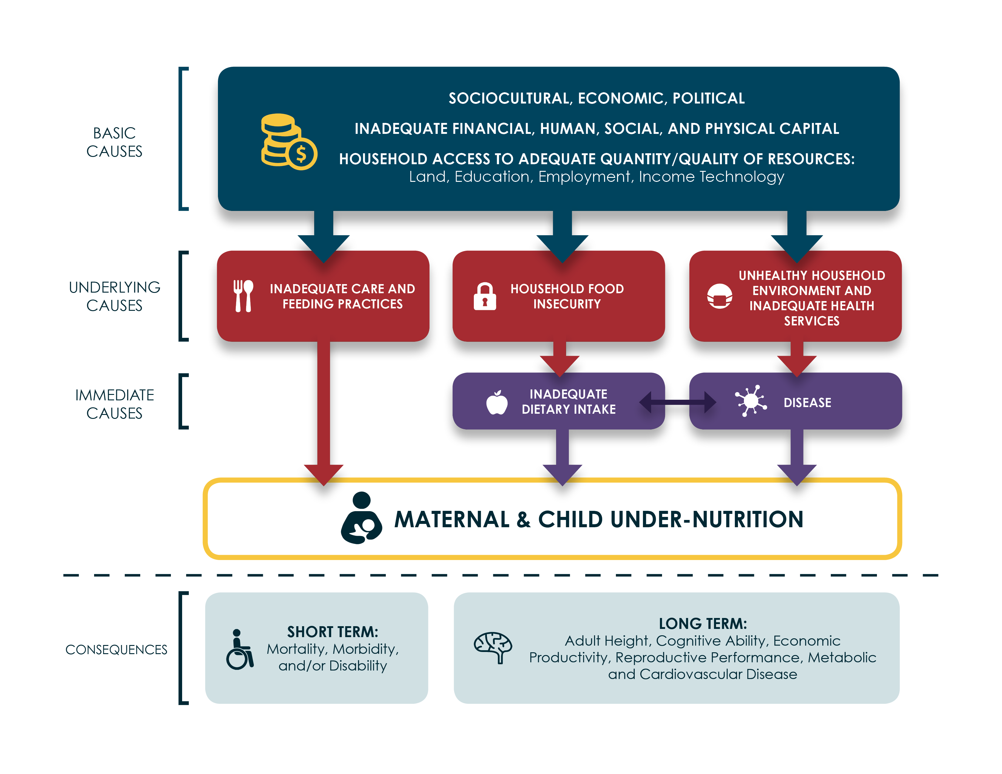
Figure 2.1. Basic, underlying and immediate causes of nutrition outcomes. Adapted from the United Nations Children’s Fund (UNICEF 2013)
Madeleine Thomson (2019). Chapter 2: Climate Impacts on Disasters, Infectious Diseases and Nutrition In “Climate Information for Public Health Action”, Eds. Thomson, M.C. & Mason, S.J. Routledge, London, UK
Notes:
Figure 2.1. Basic, underlying and immediate causes of nutrition outcomes adapted from
UNICEF (UNICEF 2013)
Madeleine Thomson (2019). Chapter 2: Climate Impacts on Disasters, Infectious Diseases and Nutrition In “Climate Information for Public Health Action”, Eds. Thomson, M.C. & Mason, S.J. Routledge, London, UK

Slide 3
Figure 2.2 Relationships between climate, agriculture, economy, nutrition and health in lower and middle-income countries (LMICs).
Madeleine Thomson (2019). Chapter 2: Climate Impacts on Disasters, Infectious Diseases and Nutrition In “Climate Information for Public Health Action”, Eds. Thomson, M.C. & Mason, S.J. Routledge, London, UK
Notes:
Figure 2.2 Relationships between Climate, Agriculture, Economy, Nutrition and Health in Lower and Middle Income Countries(LMICs).
Madeleine Thomson (2019). Chapter 2: Climate Impacts on Disasters, Infectious Diseases and Nutrition In “Climate Information for Public Health Action”, Eds. Thomson, M.C. & Mason, S.J. Routledge, London, UK

Slide 4
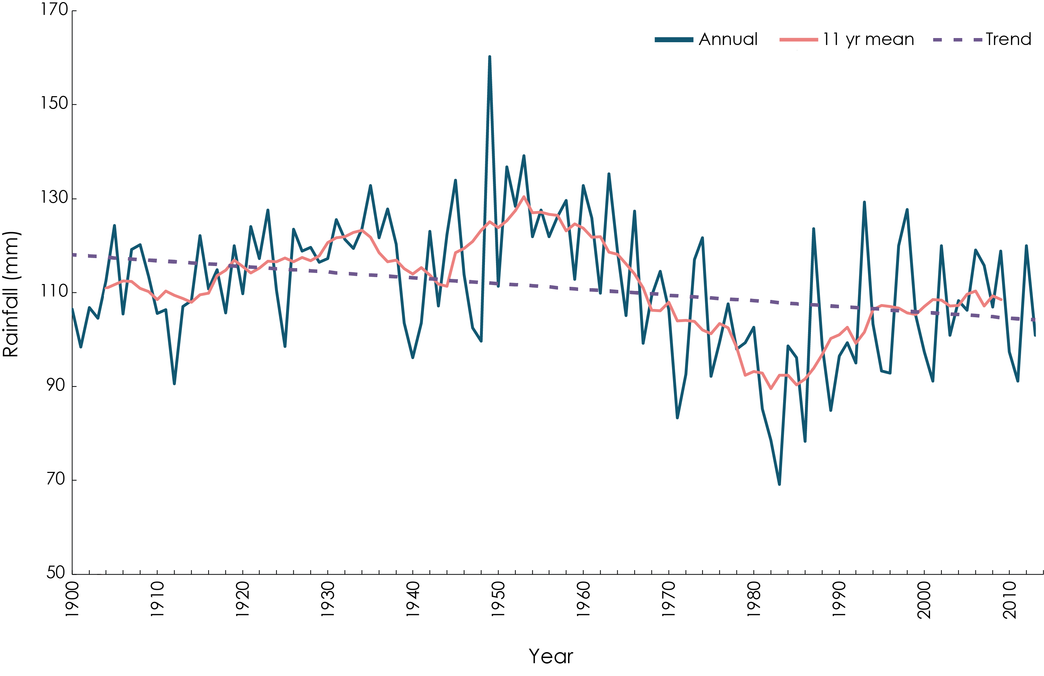
Figure 2.3 Rainfall variability in the Sahel at multiple timescales. Rainfall data from UEA/.CRU/.TS3p23
Madeleine C. Thomson (2019). Chapter 2: Climate Impacts on Disasters, Infectious Diseases and Nutrition In “Climate Information for Public Health Action”, Eds. Thomson, M.C. & Mason, S.J. Routledge, London, UK
Notes:
Figure 2.3 Rainfall variability in the Sahel at multiple time scales. Rainfall data from
UEA/.CRU/.TS3p23
Madeleine C. Thomson (2019). Chapter 2: Climate Impacts on Disasters, Infectious Diseases and Nutrition In “Climate Information for Public Health Action”, Eds. Thomson, M.C. & Mason, S.J. Routledge, London, UK

Slide 5
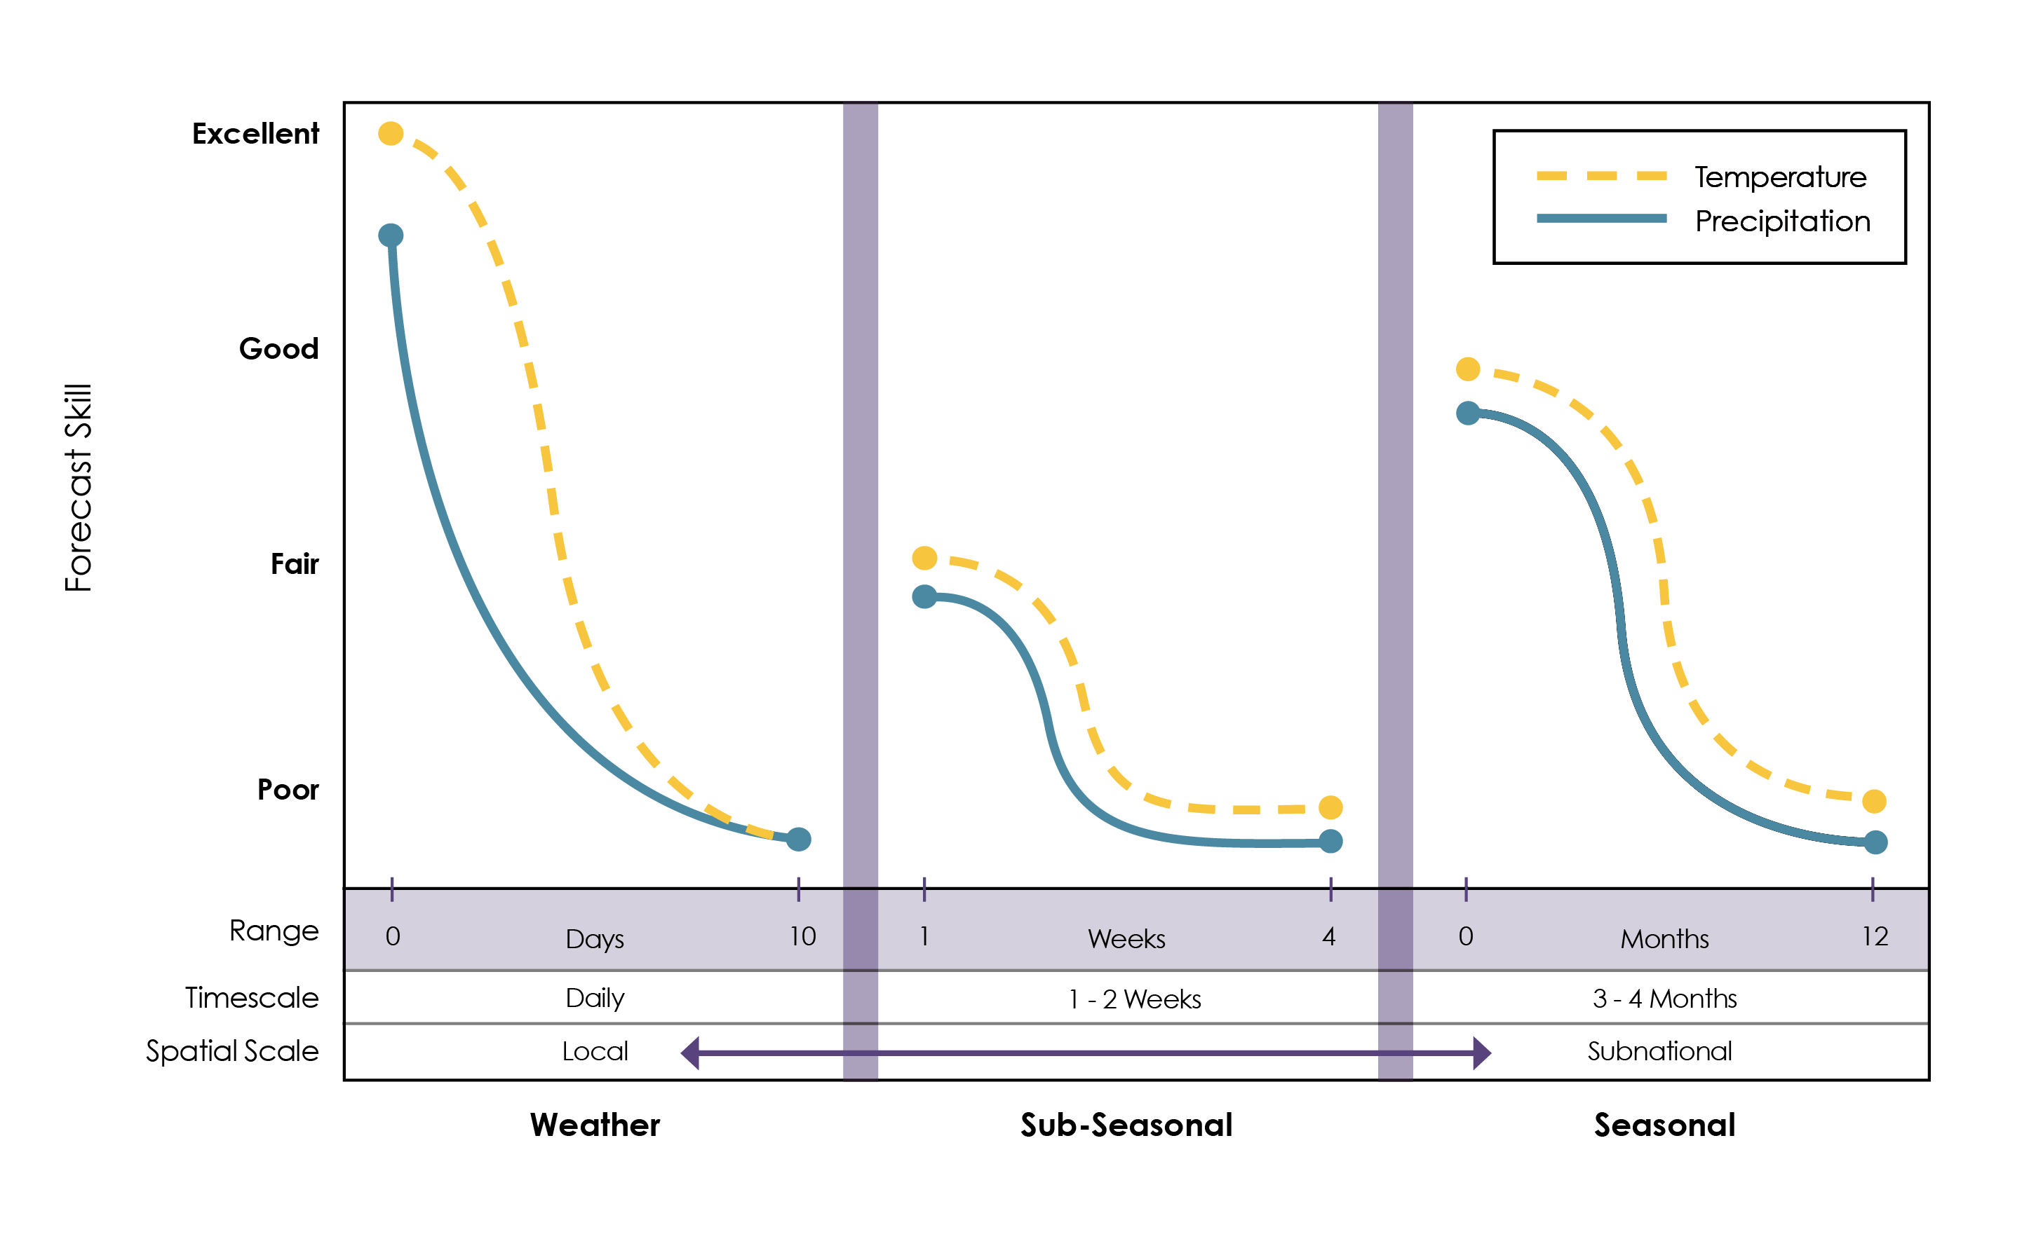
Figure 3.1 Best forecast skill at multiple timescales with indications of the forecast ranges, timescale and spatial scales over which the forecasts are averaged.
Madeleine Thomson, Jessica Metcalf, Simon Mason (2019) Chapter 3: Connecting Climate Information with Health Outcomes. In “Climate Information for Public Health Action”, Eds. Thomson, M.C. & Mason, S.J. Routledge, London, UK
Notes:
Figure 3.1 Best forecast skill at multiple timescales with indications of the forecast ranges, timescale and spatial scales over which the forecasts are averaged.
Madeleine Thomson, Jessica Metcalf, Simon Mason (2019) Chapter 3: Connecting Climate Information with Health Outcomes. In “Climate Information for Public Health Action”, Eds. Thomson, M.C. & Mason, S.J. Routledge, London, UK

Slide 6
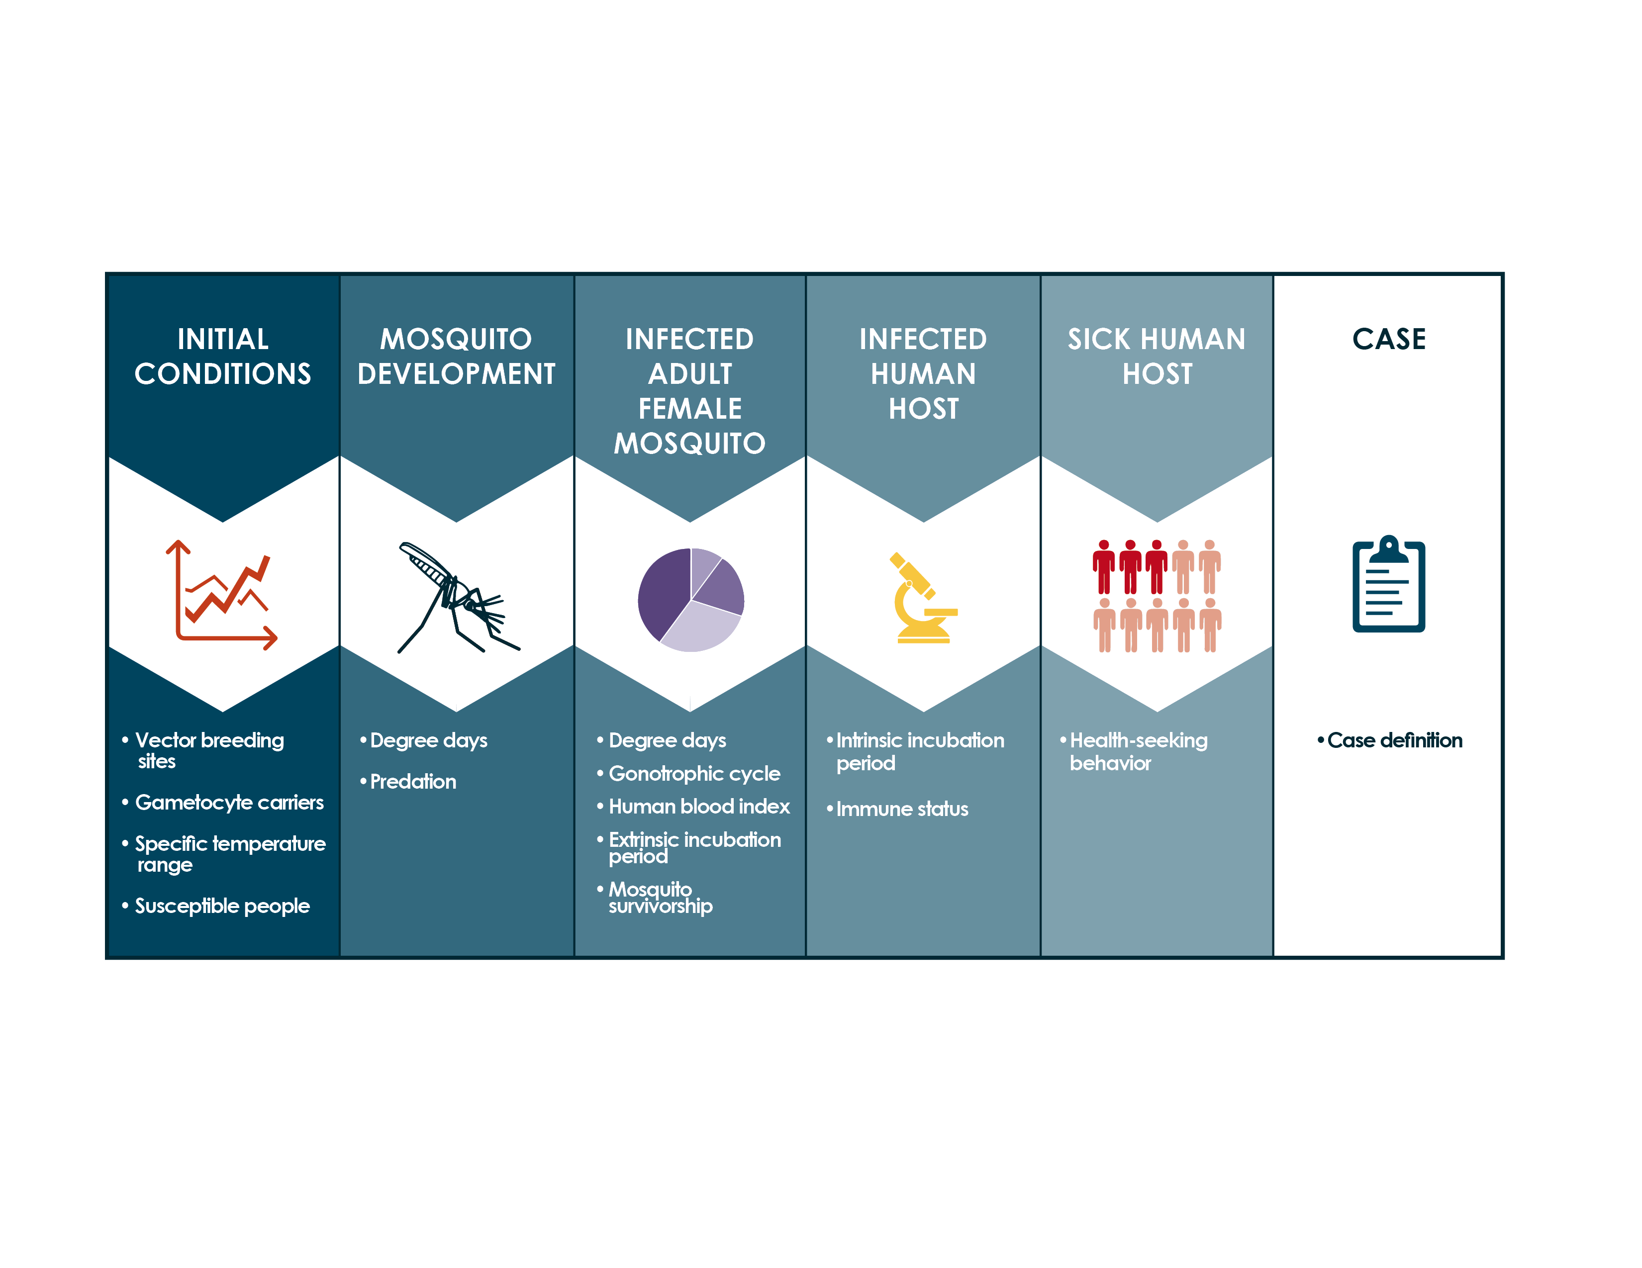
Figure 3.2 Understanding lags between climatic events and cases of disease
Madeleine Thomson, Jessica Metcalf, Simon Mason (2019) Chapter 3: Connecting Climate Information with Health Outcomes. In “Climate Information for Public Health Action”, Eds. Thomson, M.C. & Mason, S.J. Routledge, London, UK
Notes:
Figure 3.2 Understanding Lags between climatic events and cases of disease
Madeleine Thomson, Jessica Metcalf, Simon Mason (2019) Chapter 3: Connecting Climate Information with Health Outcomes. In “Climate Information for Public Health Action”, Eds. Thomson, M.C. & Mason, S.J. Routledge, London, UK

Slide 7
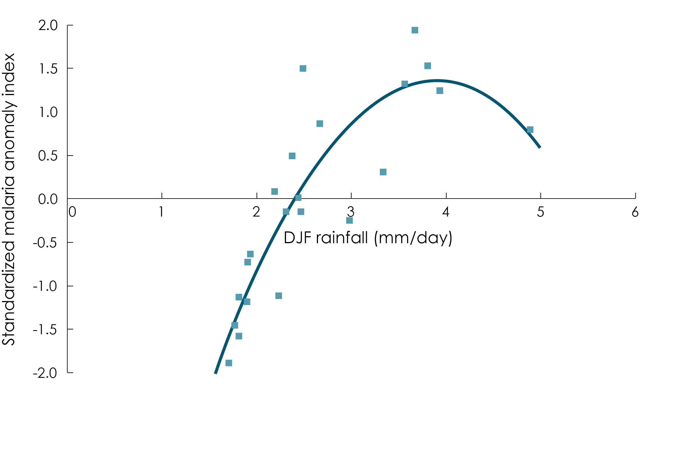
Figure 3.3 Relationship between annual malaria anomalies and December to January rainfall in Botswana
Madeleine C. Thomson, Jessica Metcalf, Simon Mason (2019) Chapter 3: Connecting Climate Information with Health Outcomes. In “Climate Information for Public Health Action”, Eds. Thomson, M.C. & Mason, S.J. Routledge, London, UK
Notes:
Figure 3.3 Relationship between annual malaria anomalies and December to January rainfall in
Botswana
Madeleine C. Thomson, Jessica Metcalf, Simon Mason (2019) Chapter 3: Connecting Climate Information with Health Outcomes. In “Climate Information for Public Health Action”, Eds. Thomson, M.C. & Mason, S.J. Routledge, London, UK

Slide 8
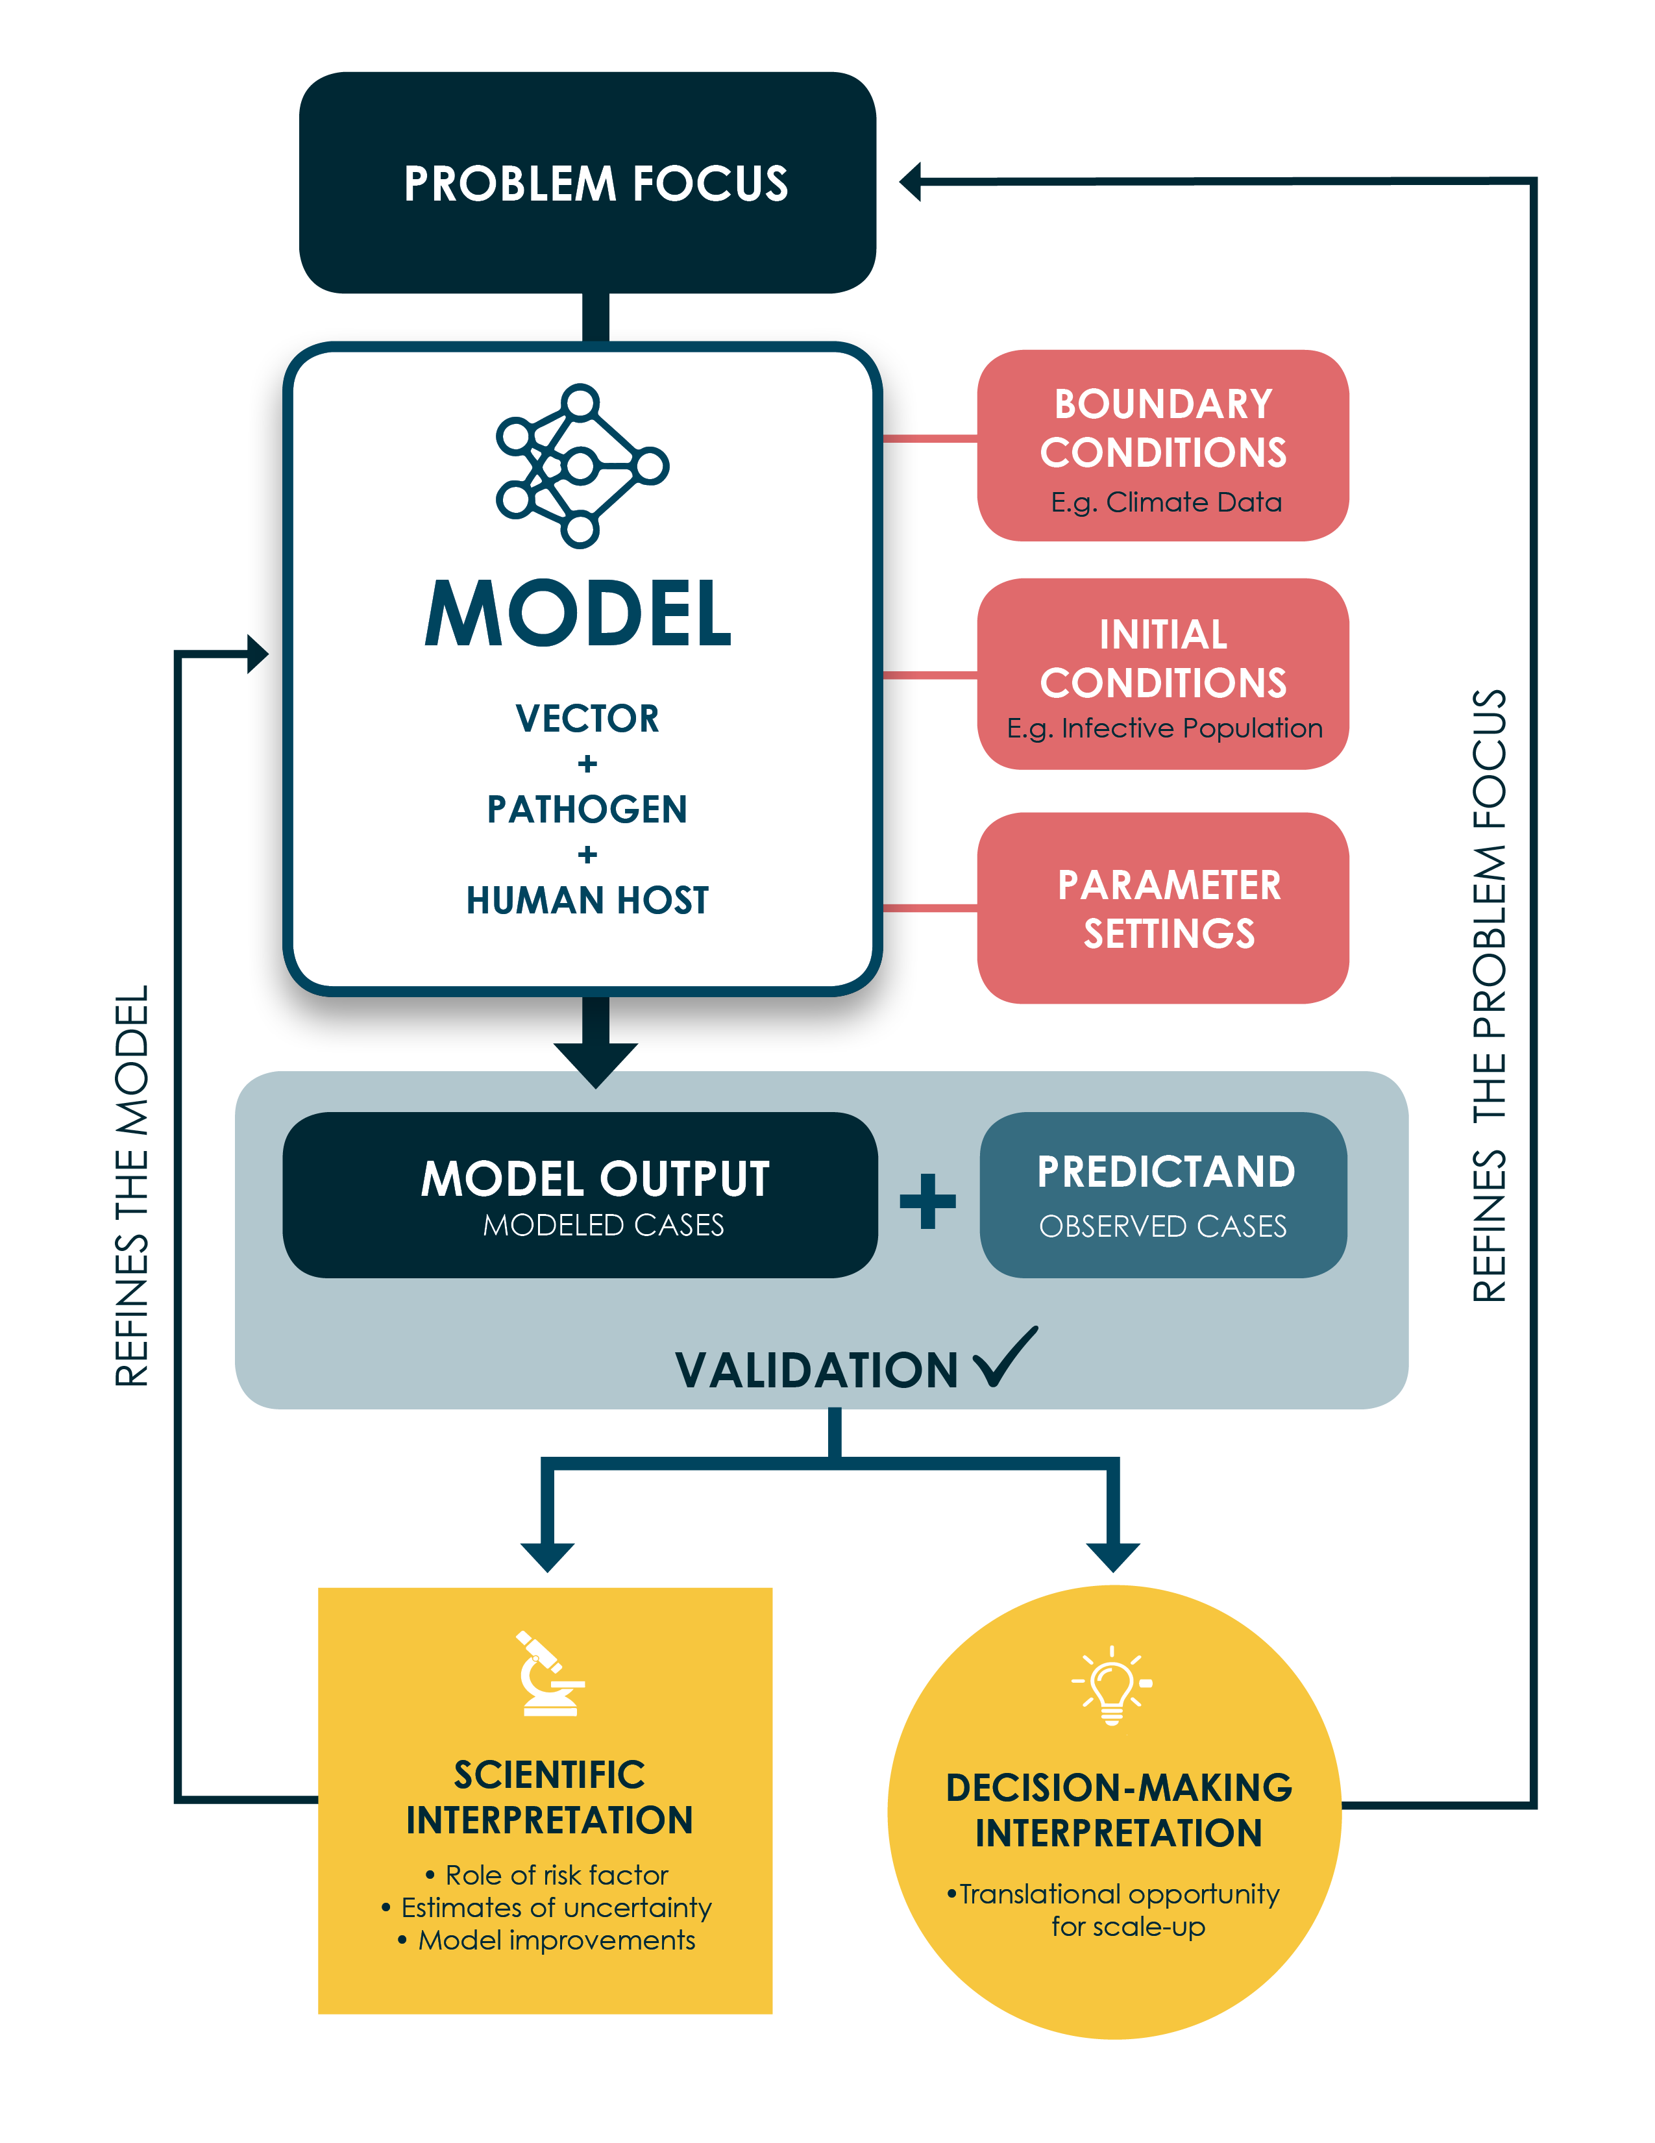
Figure 3.4. Schematic of the potential sources of uncertainty when using a weather/climate-sensitive disease model to simulate observed health outcomes
Madeleine Thomson, Jessica Metcalf, Simon Mason (2019) Chapter 3: Connecting Climate Information with Health Outcomes. In “Climate Information for Public Health Action”, Eds. Thomson, M.C. & Mason, S.J. Routledge, London, UK
Notes:
Figure 3.4. Schematic of the potential sources of uncertainty when using a weather/climate-sensitive disease model to simulate observed health outcomes
Madeleine Thomson, Jessica Metcalf, Simon Mason (2019) Chapter 3: Connecting Climate Information with Health Outcomes. In “Climate Information for Public Health Action”, Eds. Thomson, M.C. & Mason, S.J. Routledge, London, UK

Slide 9
Figure 4.1 Latitudinal zones.
Simon Mason, Chapter 4 Climate Basics (2019) In “Climate Information for Public Health Action”, Eds. Thomson, M.C. & Mason, S.J. Routledge, London, UK
Notes:
Figure 4.5: Frequency distributions of daily (left) and monthly (right) rainfall accumulations for Barbados for the wet season (August – November) 1981 - 2010. The dotted vertical lines on the right diagram indicate the lower and upper terciles and the corresponding categories, and the solid curve indicates a gamma distribution fit to the data.
Simon Mason, Chapter 4 Climate Basics (2019) In “Climate Information for Public Health Action”, Eds. Thomson, M.C. & Mason, S.J. Routledge, London, UK

Slide 10
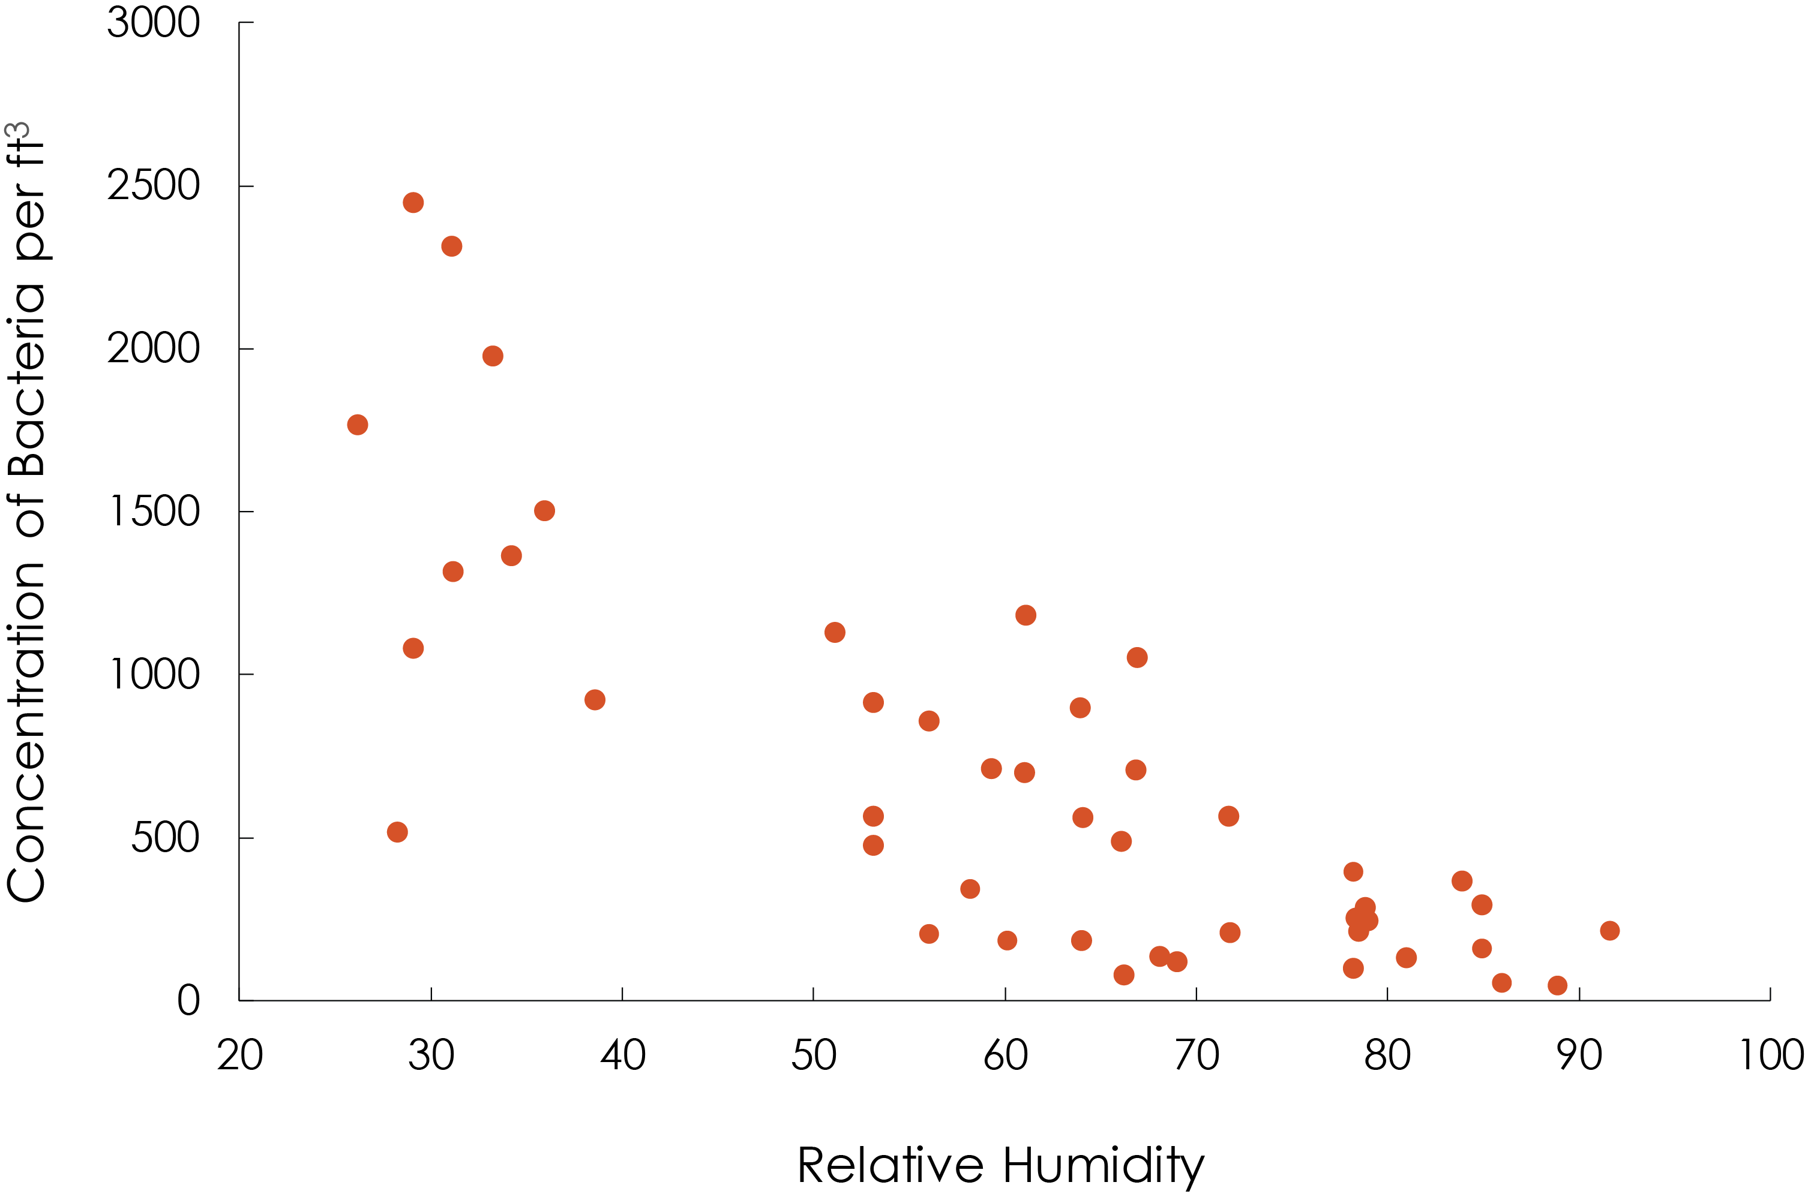
Figure 4.2 Concentration of airborne bacteria in relation to humidity in Mali
Simon Mason, Chapter 4 Climate Basics (2019) In “Climate Information for Public Health Action”, Eds. Thomson, M.C. & Mason, S.J. Routledge, London, UK
Notes:
Figure 4.2 Concentration of airborne bacteria in relation to humidity in Mali
Simon Mason, Chapter 4 Climate Basics (2019) In “Climate Information for Public Health Action”, Eds. Thomson, M.C. & Mason, S.J. Routledge, London, UK

Slide 11
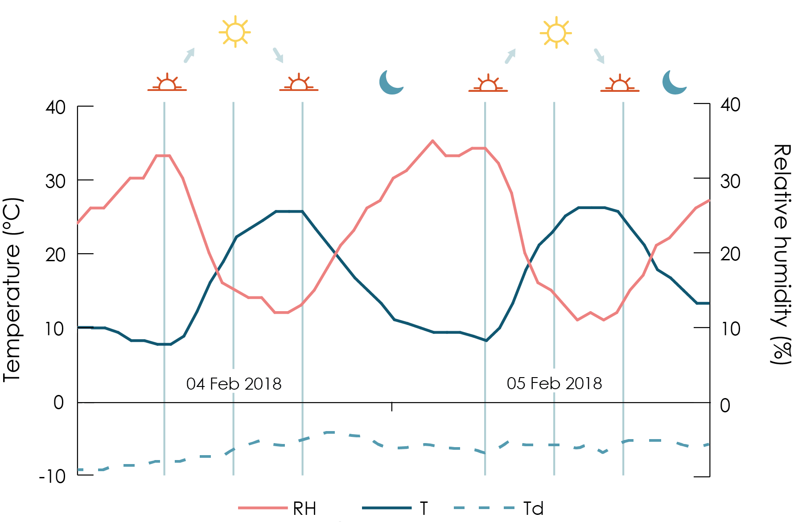
Figure 4.3 Hourly temperature (T; thin teal line), dewpoint temperature (Td; dashed line) and relative humidity (RH; thick orange line) in Tucson, AZ, for 4 and 5 February 2018. The times of sunrise, high noon, and sunset are shown by the symbols and thin vertical lines. The correlation between the temperature and the relative humidity is -0.97.
Simon Mason, Chapter 4 Climate Basics (2019) In “Climate Information for Public Health Action”, Eds. Thomson, M.C. & Mason, S.J. Routledge, London, UK
Notes:
Figure 4.3 Hourly temperature (T; teal line), dewpoint temperature (Td; dashed line) and relative humidity (RH; orange line) in Tucson, AZ, for 4 and 5 February 2018. The times of sunrise, high noon, and sunset are shown by the symbols and thin vertical lines. The correlation between the temperature and the relative humidity is -0.97.
Simon Mason, Chapter 4 Climate Basics (2019) In “Climate Information for Public Health Action”, Eds. Thomson, M.C. & Mason, S.J. Routledge, London, UK

Slide 12
Figure 4.4 Locations of monsoon regions, as defined by areas that receive at least 70% of their annual rainfall during May – September (Southern Hemisphere [SH] winter / Northern Hemisphere [NH] summer) or November–March (SH summer / NH winter). The monsoons are labelled by the season in which the winds bring rain. (Data source: ECMWF Interim Reanalysis, for January 1981–March 2010; (Dee et al. 2011) )
Simon Mason, Chapter 4 Climate Basics (2019) In “Climate Information for Public Health Action”, Eds. Thomson, M.C. & Mason, S.J. Routledge, London, UK
Notes:
Figure 4.4 Locations of monsoon regions, as defined by areas that receive at least 70% of their annual rainfall during May – September (Southern Hemisphere [SH] winter / Northern Hemisphere [NH] summer) or November–March (SH summer / NH winter). The monsoons are labelled by the season in which the winds bring rain. (Data source: ECMWF Interim Reanalysis, for January 1981–March 2010; (Dee et al. 2011) )
Simon Mason, Chapter 4 Climate Basics (2019) In “Climate Information for Public Health Action”, Eds. Thomson, M.C. & Mason, S.J. Routledge, London, UK

Slide 13
Figure 4.5 Global distribution of tropical cyclone tracks, 1991 – 2010. (Data source: International Best Track Archive for Climate Stewardship (IBTrACS) version 3.)
Simon Mason, Chapter 4 Climate Basics (2019) In “Climate Information for Public Health Action”, Eds. Thomson, M.C. & Mason, S.J. Routledge, London, UK
Notes:
Figure 4.5 Global distribution of tropical cyclone tracks, 1991 – 2010. (Data source: International Best Track Archive for Climate Stewardship (IBTrACS) version 3.)
Simon Mason, Chapter 4 Climate Basics (2019) In “Climate Information for Public Health Action”, Eds. Thomson, M.C. & Mason, S.J. Routledge, London, UK

Slide 14
Figure 4.6 Typical structure of a mature extratropical cyclone. The arrows indicate the near-surface wind direction, and the near-concentric circles represent lines of equal air pressure, with “L” indicating lowest air pressure in the centre. The shading indicates areas of rainfall and the thick lines indicate the fronts (the bobbled line is the warm front, and the pointed line is the cold front). North is marked by the crossed arrow.
Simon Mason, Chapter 4 Climate Basics (2019) In “Climate Information for Public Health Action”, Eds. Thomson, M.C. & Mason, S.J. Routledge, London, UK
Notes:
Figure 4.6 Typical structure of a mature extratropical cyclone. The arrows indicate the near-surface wind direction, and the near-concentric circles represent lines of equal air pressure, with “L” indicating lowest air pressure in the centre. The shading indicates areas of rainfall and the thick lines indicate the fronts (the bobbled line is the warm front, and the pointed line is the cold front). North is marked by the crossed arrow.
Simon Mason, Chapter 4 Climate Basics (2019) In “Climate Information for Public Health Action”, Eds. Thomson, M.C. & Mason, S.J. Routledge, London, UK

Slide 15
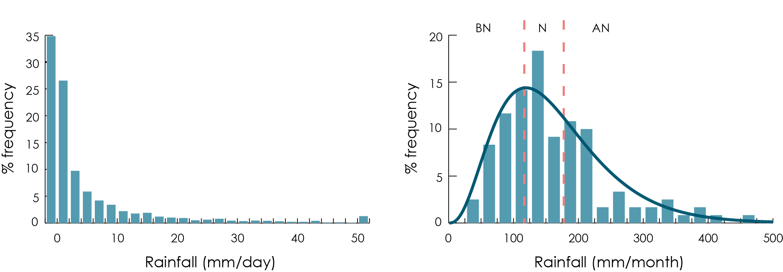
Figure 4.7 Frequency distributions of daily (left) and monthly (right) rainfall accumulations for Barbados for the wet season (August – November) 1981 - 2010. The dotted vertical lines on the right diagram indicate the lower and upper terciles and the corresponding categories, and the solid curve indicates a gamma distribution fit to the data.
Simon Mason, Chapter 4 Climate Basics (2019) In “Climate Information for Public Health Action”, Eds. Thomson, M.C. & Mason, S.J. Routledge, London, UK
Notes:
Figure 4.7 Frequency distributions of daily (left) and monthly (right) rainfall accumulations for Barbados for the wet season (August – November) 1981 - 2010. The dotted vertical lines on the right diagram indicate the lower and upper terciles and the corresponding categories, and the solid curve indicates a gamma distribution fit to the data.
Simon Mason, Chapter 4 Climate Basics (2019) In “Climate Information for Public Health Action”, Eds. Thomson, M.C. & Mason, S.J. Routledge, London, UK

Slide 16
January
July
Figure 5.1: Average temperatures for January (top) and July (bottom) 1981 – 2010. Data source: ECMWF Interim Reanalysis, for 1981 – 2010 (Dee et al. 2011).
Simon Mason, Ángel G. Muñoz, Bradfield Lyon, Madeleine C Thomson. Chapter 5: Climate Variability and Trends: Drivers (2019) In “Climate Information for Public Health Action”, Eds. Thomson, M.C. & Mason, S.J. Routledge, London, UK
Notes:
Figure 5.1: Average temperatures for January (top) and July (bottom) 1981 – 2010. Data source: ECMWF Interim Reanalysis, for 1981 – 2010 (Dee et al. 2011).
Simon Mason, Ángel G. Muñoz, Bradfield Lyon, Madeleine C Thomson. Chapter 5: Climate Variability and Trends: Drivers (2019) In “Climate Information for Public Health Action”, Eds. Thomson, M.C. & Mason, S.J. Routledge, London, UK

Slide 17
January
July
Figure 5.2: Average rainfall for January (top) and July (bottom) 1981 – 2010. Data source: ECMWF Interim Reanalysis, for 1981 – 2010 (Dee et al. 2011).
Simon Mason, Ángel G. Muñoz, Bradfield Lyon, Madeleine C Thomson. Chapter 5: Climate Variability and Trends: Drivers (2019) In “Climate Information for Public Health Action”, Eds. Thomson, M.C. & Mason, S.J. Routledge, London, UK
Notes:
Figure 5.2: Average rainfall for January (top) and July (bottom) 1981 – 2010. Data source: ECMWF Interim Reanalysis, for 1981 – 2010 (Dee et al. 2011).
Simon Mason, Ángel G. Muñoz, Bradfield Lyon, Madeleine C Thomson. Chapter 5: Climate Variability and Trends: Drivers (2019) In “Climate Information for Public Health Action”, Eds. Thomson, M.C. & Mason, S.J. Routledge, London, UK

Slide 18
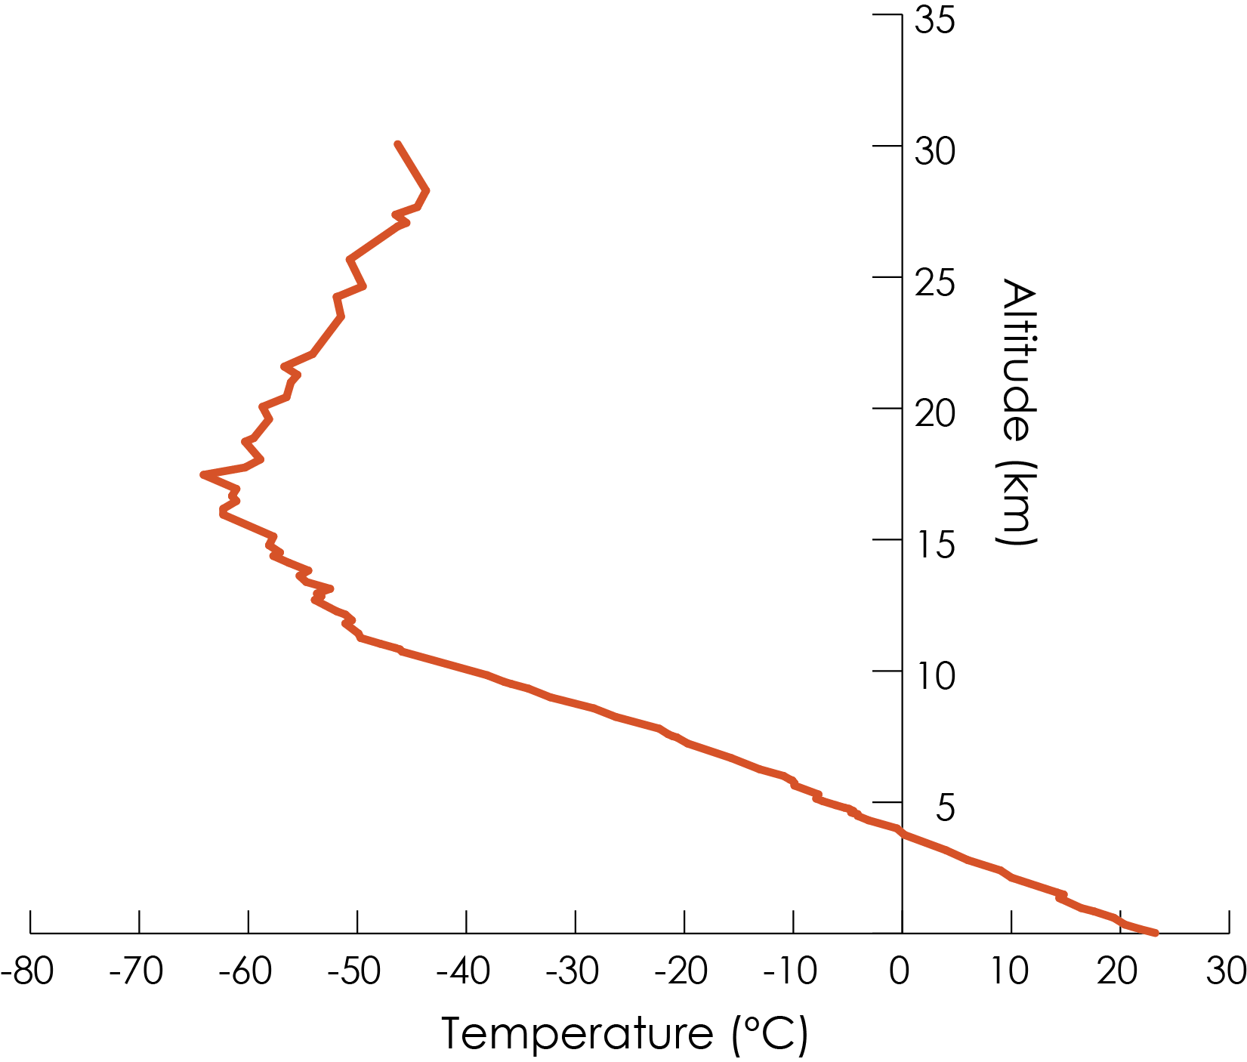
Figure 5.3: Temperature as a function of altitude over Brookhaven, NY, at 08h00 local time on 3 August 2017 (Data source: https://ruc.noaa.gov/raobs/).
Simon Mason, Ángel G. Muñoz, Bradfield Lyon, Madeleine C Thomson. Chapter 5: Climate Variability and Trends: Drivers (2019) In “Climate Information for Public Health Action”, Eds. Thomson, M.C. & Mason, S.J. Routledge, London, UK
Notes:
Figure 5.3: Temperature as a function of altitude over Brookhaven, NY, at 08h00 local time on 3 August 2017 (Data source: https://ruc.noaa.gov/raobs/).
Simon Mason, Ángel G. Muñoz, Bradfield Lyon, Madeleine C Thomson. Chapter 5: Climate Variability and Trends: Drivers (2019) In “Climate Information for Public Health Action”, Eds. Thomson, M.C. & Mason, S.J. Routledge, London, UK

Slide 19
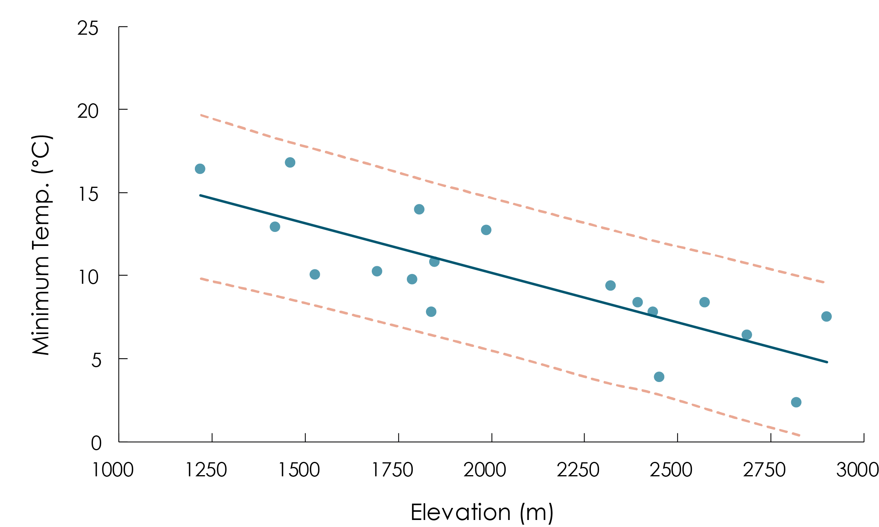
Figure 5.4 Climatological (1981–2010) monthly average minimum temperature (°C) as a function of elevation for 18 stations in the Ethiopian Highlands (locations shown in insert). Points indicate the lowest climatological monthly minimum temperature during the calendar year, with the solid line showing a least squares linear fit and dashed lines indicating the 95% confidence limits for predicted values
Simon Mason, Ángel G. Muñoz, Bradfield Lyon, Madeleine C Thomson. Chapter 5: Climate Variability and Trends: Drivers (2019) In “Climate Information for Public Health Action”, Eds. Thomson, M.C. & Mason, S.J. Routledge, London, UK
Notes:
Figure 5.4 Climatological (1981–2010) monthly average minimum temperature (°C) as a function of elevation for 18 stations in the Ethiopian Highlands (locations shown in insert). Points indicate the lowest climatological monthly minimum temperature during the calendar year, with the solid line showing a least squares linear fit and dashed lines indicating the 95% confidence limits for predicted values
Simon Mason, Ángel G. Muñoz, Bradfield Lyon, Madeleine C Thomson. Chapter 5: Climate Variability and Trends: Drivers (2019) In “Climate Information for Public Health Action”, Eds. Thomson, M.C. & Mason, S.J. Routledge, London, UK

Slide 20
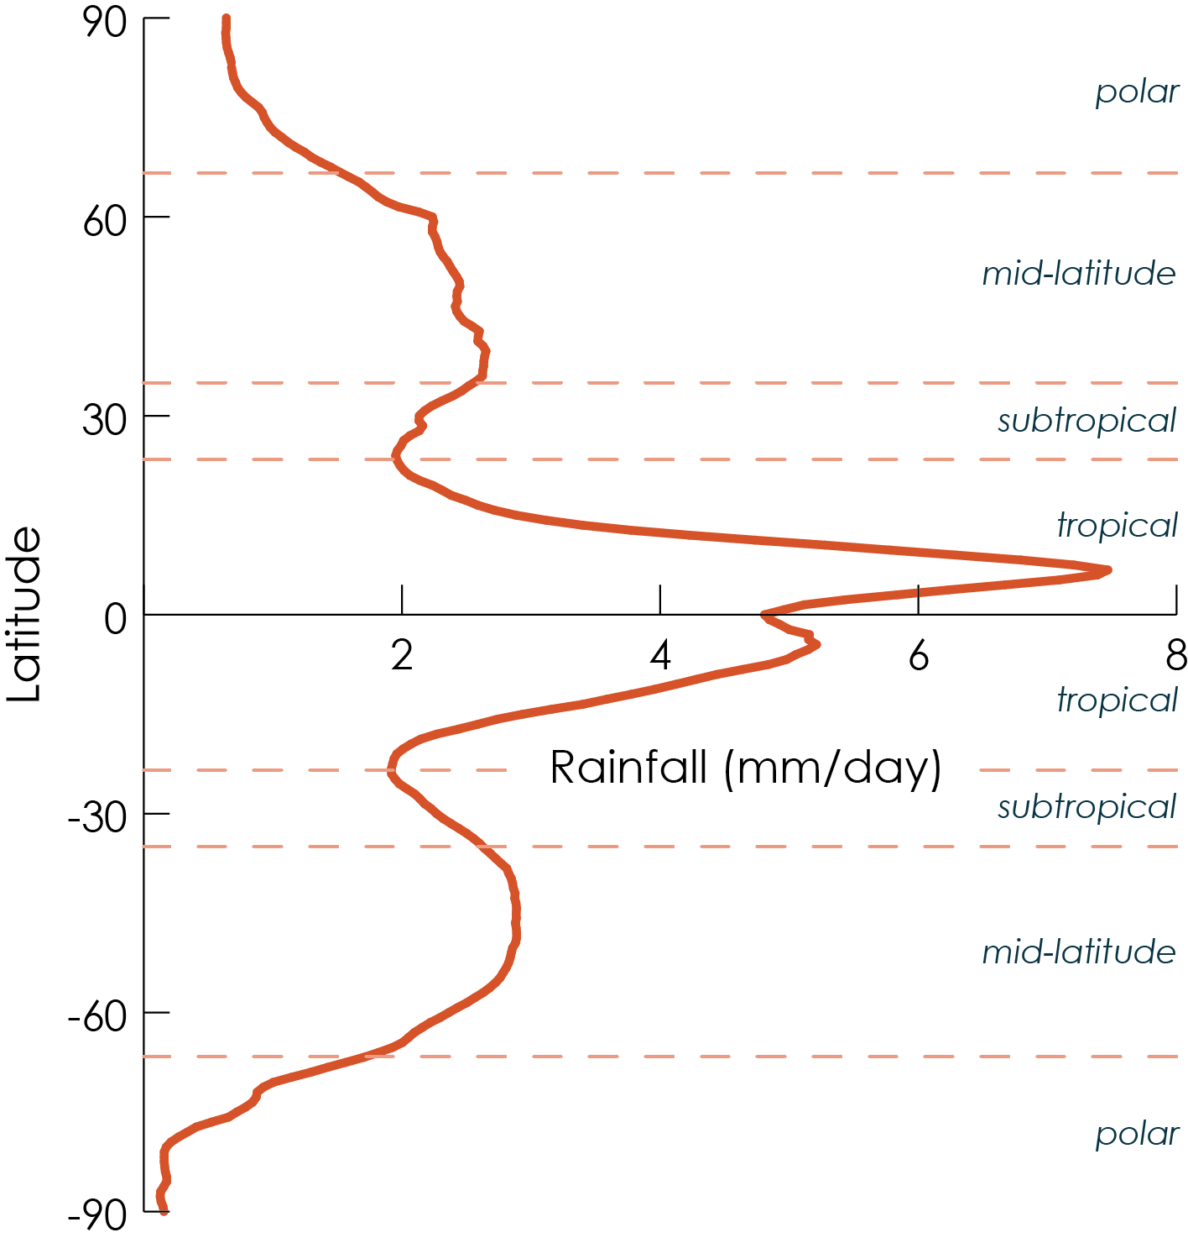
Figure 5.5 Rainfall (and snow) as a function of latitude (the North Pole is at the top; the South Pole at the bottom). Data source: ECMWF Interim Reanalysis, for 1981 – 2010 (Dee et al. 2011).
Simon Mason, Ángel G. Muñoz, Bradfield Lyon, Madeleine C Thomson. Chapter 5: Climate Variability and Trends: Drivers (2019) In “Climate Information for Public Health Action”, Eds. Thomson, M.C. & Mason, S.J. Routledge, London, UK
Notes:
Figure 5.5 Rainfall (and snow) as a function of latitude (the North Pole is at the top; the South Pole at the bottom). Data source: ECMWF Interim Reanalysis, for 1981 – 2010 (Dee et al. 2011).
Simon Mason, Ángel G. Muñoz, Bradfield Lyon, Madeleine C Thomson. Chapter 5: Climate Variability and Trends: Drivers (2019) In “Climate Information for Public Health Action”, Eds. Thomson, M.C. & Mason, S.J. Routledge, London, UK

Slide 21
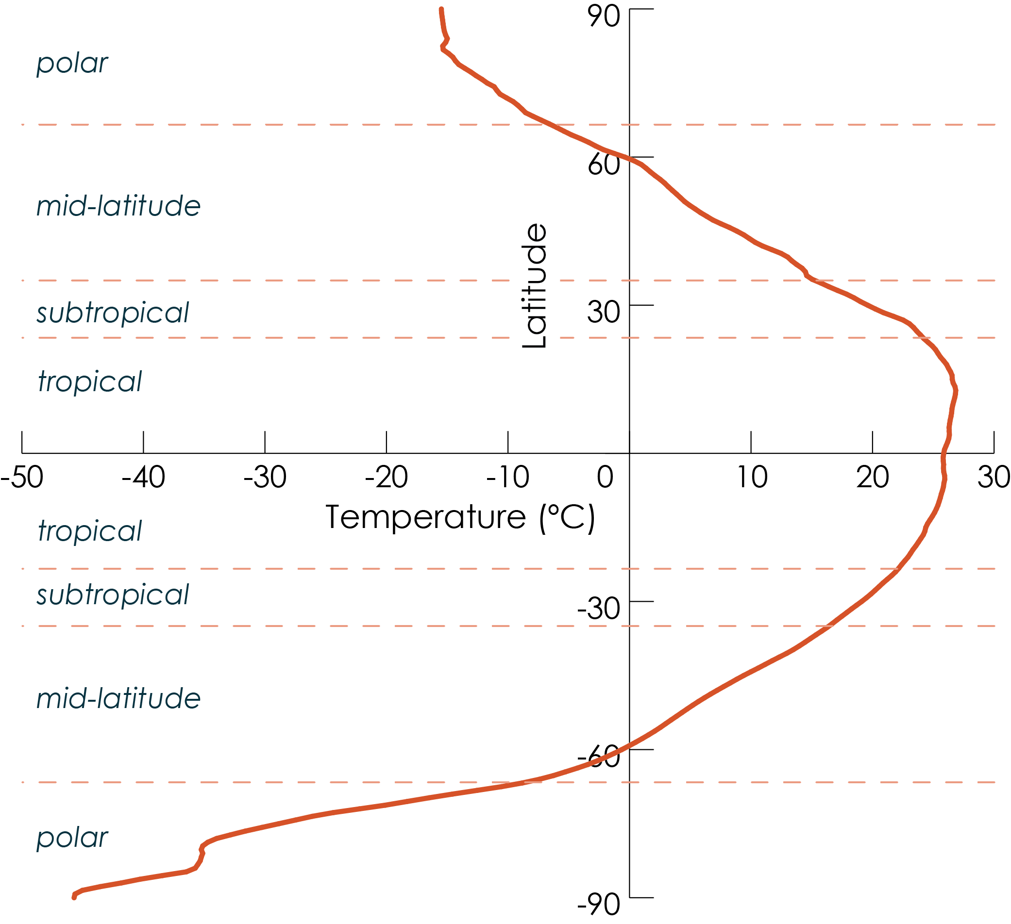
Figure 5.6 Temperature as a function of latitude (the North Pole is at the top; the South Pole at the bottom). Data source: ECMWF Interim Reanalysis, for 1981 – 2010
Simon Mason, Ángel G. Muñoz, Bradfield Lyon, Madeleine C Thomson. Chapter 5: Climate Variability and Trends: Drivers (2019) In “Climate Information for Public Health Action”, Eds. Thomson, M.C. & Mason, S.J. Routledge, London, UK
Notes:
Figure 5.6 Temperature as a function of latitude (the North Pole is at the top; the South Pole at the bottom). Data source: ECMWF Interim Reanalysis, for 1981 – 2010 (Dee et al. 2011).
Simon Mason, Ángel G. Muñoz, Bradfield Lyon, Madeleine C Thomson. Chapter 5: Climate Variability and Trends: Drivers (2019) In “Climate Information for Public Health Action”, Eds. Thomson, M.C. & Mason, S.J. Routledge, London, UK

Slide 22
Figure 5.7 The annual range in temperature, calculated as the difference between the warmest and coldest mean monthly temperature. (Scale is from 0 [black] to 40 [white]. Data source: ECMWF Interim Reanalysis, for 1981 – 2010 (Dee et al. 2011).
Simon Mason, Ángel G. Muñoz, Bradfield Lyon, Madeleine C Thomson. Chapter 5: Climate Variability and Trends: Drivers (2019) In “Climate Information for Public Health Action”, Eds. Thomson, M.C. & Mason, S.J. Routledge, London, UK
Notes:
Figure 5.7 The annual range in temperature, calculated as the difference between the warmest and coldest mean monthly temperature. (Scale is from 0 [black] to 40 [white]. Data source: ECMWF Interim Reanalysis, for 1981 – 2010 (Dee et al. 2011).
Simon Mason, Ángel G. Muñoz, Bradfield Lyon, Madeleine C Thomson. Chapter 5: Climate Variability and Trends: Drivers (2019) In “Climate Information for Public Health Action”, Eds. Thomson, M.C. & Mason, S.J. Routledge, London, UK

Slide 23
Temperature (Celsius)
Figure 5.8 Example of a cold front, occurring on 26 November 2015 over part of the USA. The front lies along the boundary between the warm air to the southeast (orange shading), and the cold air to the northwest (blue shading). The 2 m wind speeds and directions are shown by the arrows. Data source: ECMWF Interim Reanalysis, for 1981 – 2010 (Dee et al. 2011).
Simon Mason, Ángel G. Muñoz, Bradfield Lyon, Madeleine C Thomson. Chapter 5: Climate Variability and Trends: Drivers (2019) In “Climate Information for Public Health Action”, Eds. Thomson, M.C. & Mason, S.J. Routledge, London, UK
Notes:
Figure 5.8 Example of a cold front, occurring on 26 November 2015 over part of the USA. The front lies along the boundary between the warm air to the southeast (light shading), and the cold air to the northwest (dark shading). The 2 m wind speeds and directions are shown by the arrows. Data source: ECMWF Interim Reanalysis, for 1981 – 2010 (Dee et al. 2011).
Simon Mason, Ángel G. Muñoz, Bradfield Lyon, Madeleine C Thomson. Chapter 5: Climate Variability and Trends: Drivers (2019) In “Climate Information for Public Health Action”, Eds. Thomson, M.C. & Mason, S.J. Routledge, London, UK

Slide 24
Figure 5.9 Average daily-range in temperature for 1981 – 2010. Data source: ECMWF Interim Reanalysis, for 1981 – 2010 (Dee et al. 2011).
Simon Mason, Ángel G. Muñoz, Bradfield Lyon, Madeleine C Thomson. Chapter 5: Climate Variability and Trends: Drivers (2019) In “Climate Information for Public Health Action”, Eds. Thomson, M.C. & Mason, S.J. Routledge, London, UK
Notes:
Figure 5.9 Average daily-range in temperature for 1981 – 2010. Data source: ECMWF Interim Reanalysis, for 1981 – 2010 (Dee et al. 2011).
Simon Mason, Ángel G. Muñoz, Bradfield Lyon, Madeleine C Thomson. Chapter 5: Climate Variability and Trends: Drivers (2019) In “Climate Information for Public Health Action”, Eds. Thomson, M.C. & Mason, S.J. Routledge, London, UK

Slide 25
Figure 5.10 Illustration of the causes of Earth’s seasons
Simon Mason, Ángel G. Muñoz, Bradfield Lyon, Madeleine C Thomson. Chapter 5: Climate Variability and Trends: Drivers (2019) In “Climate Information for Public Health Action”, Eds. Thomson, M.C. & Mason, S.J. Routledge, London, UK
Notes:
Figure 5.10 Illustration of the causes of Earth’s seasons
Simon Mason, Ángel G. Muñoz, Bradfield Lyon, Madeleine C Thomson. Chapter 5: Climate Variability and Trends: Drivers (2019) In “Climate Information for Public Health Action”, Eds. Thomson, M.C. & Mason, S.J. Routledge, London, UK

Slide 26
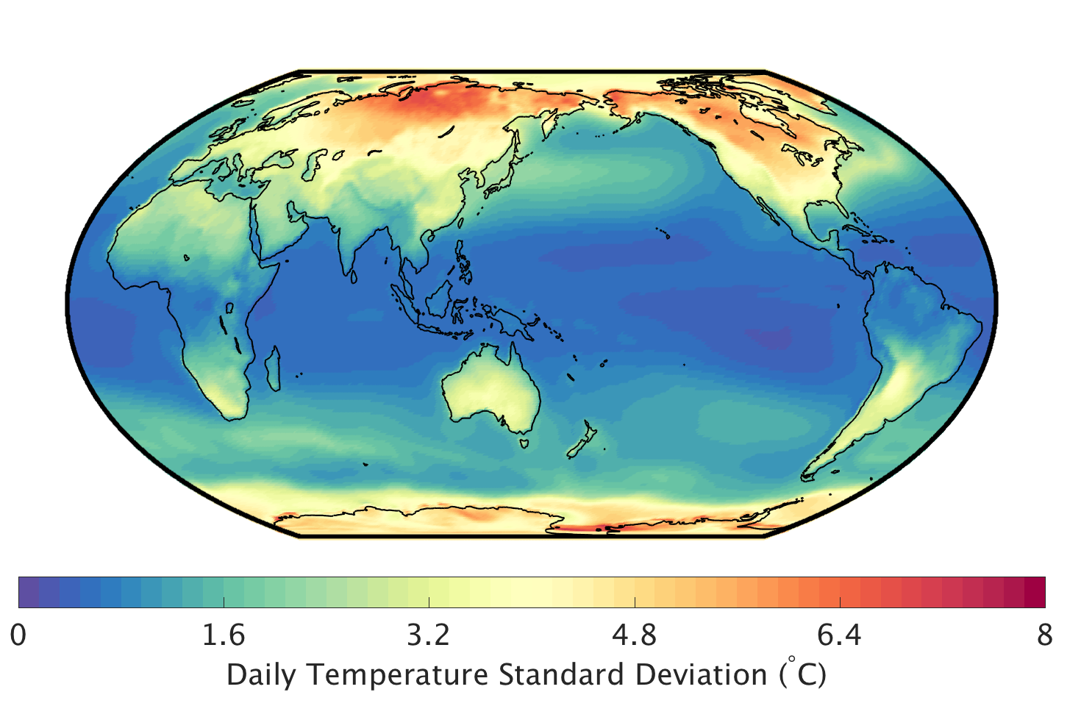
Annual
Daily
Figure 5.11 Year-to-year (top) and day-to-day (bottom) variability in temperature, as measured by the standard deviation, 1981 - 2010. Data source: ECMWF Interim Reanalysis, for 1981 – 2010 (Dee et al. 2011).
Simon Mason, Ángel G. Muñoz, Bradfield Lyon, Madeleine C Thomson. Chapter 5: Climate Variability and Trends: Drivers (2019) In “Climate Information for Public Health Action”, Eds. Thomson, M.C. & Mason, S.J. Routledge, London, UK
Notes:
Figure 5.11 Year-to-year (top) and day-to-day (bottom) variability in temperature, as measured by the standard deviation, 1981 - 2010. Data source: ECMWF Interim Reanalysis, for 1981 – 2010 (Dee et al. 2011).
Simon Mason, Ángel G. Muñoz, Bradfield Lyon, Madeleine C Thomson. Chapter 5: Climate Variability and Trends: Drivers (2019) In “Climate Information for Public Health Action”, Eds. Thomson, M.C. & Mason, S.J. Routledge, London, UK

Slide 27
Figure 5.12 The coefficient of variation of annual rainfall, 1981 – 2010. Data source: ECMWF Interim Reanalysis, for 1981 – 2010 (Dee et al. 2011).
Simon Mason, Ángel G. Muñoz, Bradfield Lyon, Madeleine C Thomson. Chapter 5: Climate Variability and Trends: Drivers (2019) In “Climate Information for Public Health Action”, Eds. Thomson, M.C. & Mason, S.J. Routledge, London, UK
Notes:
Figure 5.12 The coefficient of variation of annual rainfall, 1981 – 2010. Data source: ECMWF Interim Reanalysis, for 1981 – 2010 (Dee et al. 2011).
Simon Mason, Ángel G. Muñoz, Bradfield Lyon, Madeleine C Thomson. Chapter 5: Climate Variability and Trends: Drivers (2019) In “Climate Information for Public Health Action”, Eds. Thomson, M.C. & Mason, S.J. Routledge, London, UK

Slide 28
Figure 5.13 Sea-surface temperatures during (top) a strong El Niño event (Dec 1997 – Feb 1998), and (bottom) a strong La Niña event (Dec 1998 – Feb 1999). Data source: OISST2(Reynolds et al. 2007).
Simon Mason, Ángel G. Muñoz, Bradfield Lyon, Madeleine C Thomson. Chapter 5: Climate Variability and Trends: Drivers (2019) In “Climate Information for Public Health Action”, Eds. Thomson, M.C. & Mason, S.J. Routledge, London, UK
Notes:
Figure 5.13 Sea-surface temperatures during (top) a strong El Niño event (Dec 1997 – Feb 1998), and (bottom) a strong La Niña event (Dec 1998 – Feb 1999). Data source: OISST2(Reynolds et al. 2007).
Simon Mason, Ángel G. Muñoz, Bradfield Lyon, Madeleine C Thomson. Chapter 5: Climate Variability and Trends: Drivers (2019) In “Climate Information for Public Health Action”, Eds. Thomson, M.C. & Mason, S.J. Routledge, London, UK

Slide 29
Figure 5.14 Average December – February sea-surface temperatures, 1982 – 2017. The black diamonds indicate the locations of Darwin and Tahiti, which are used in the calculation of the Southern Oscillation Index. Data source: OISST2(Reynolds et al. 2007).
Simon Mason, Ángel G. Muñoz, Bradfield Lyon, Madeleine C Thomson. Chapter 5: Climate Variability and Trends: Drivers (2019) In “Climate Information for Public Health Action”, Eds. Thomson, M.C. & Mason, S.J. Routledge, London, UK
Notes:
Figure 5.14 Average December – February sea-surface temperatures, 1982 – 2017. The black diamonds indicate the locations of Darwin and Tahiti, which are used in the calculation of the Southern Oscillation Index. Data source: OISST2(Reynolds et al. 2007).
Simon Mason, Ángel G. Muñoz, Bradfield Lyon, Madeleine C Thomson. Chapter 5: Climate Variability and Trends: Drivers (2019) In “Climate Information for Public Health Action”, Eds. Thomson, M.C. & Mason, S.J. Routledge, London, UK

Slide 30
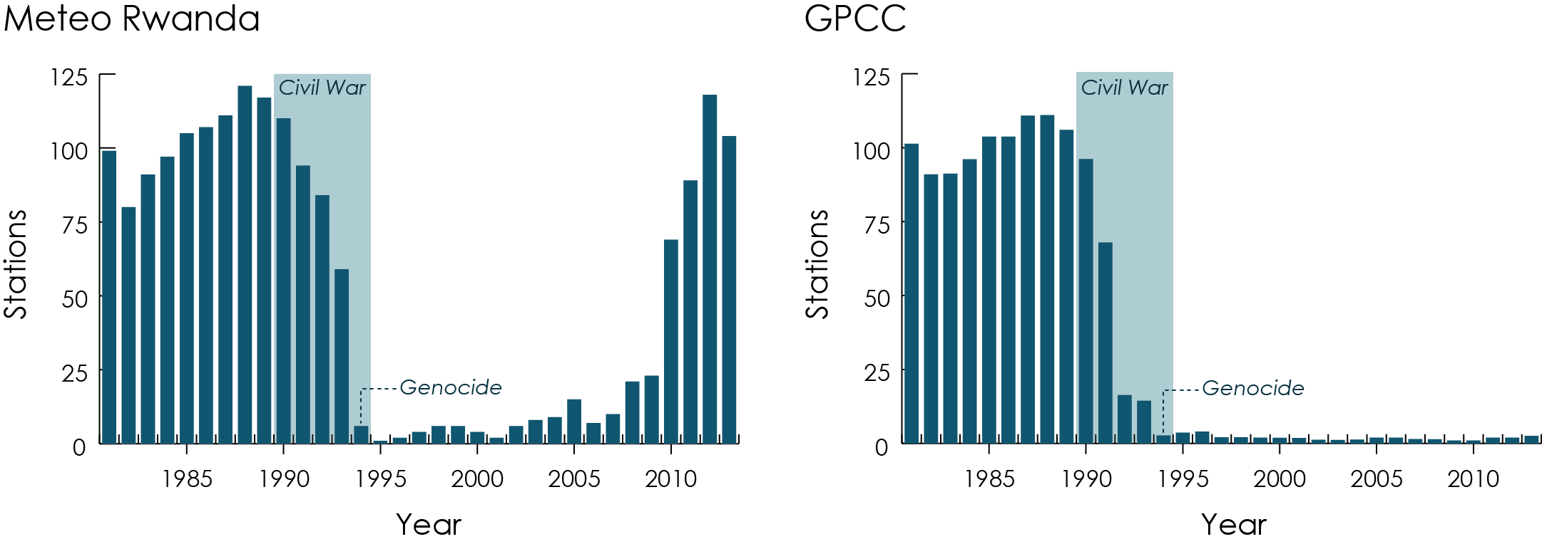
Figure 6.1 Number of functioning Meteorological stations by year in Rwanda that provide data in a) ENACTS and b) GPCC rainfall products
Simon Mason Pietro Ceccato, and Chris D. Hewitt. Chapter 6: Climate data: the past and present (2019) In “Climate Information for Public Health Action”, Eds. Thomson, M.C. & Mason, S.J. Routledge, London, UK
Notes:
Figure 6.1 Number of functioning Meteorological stations by year in Rwanda that provide data in a) ENACTS and b) GPCC rainfall products
Simon Mason Pietro Ceccato, and Chris D. Hewitt. Chapter 6: Climate data: the past and present (2019) In “Climate Information for Public Health Action”, Eds. Thomson, M.C. & Mason, S.J. Routledge, London, UK

Slide 31
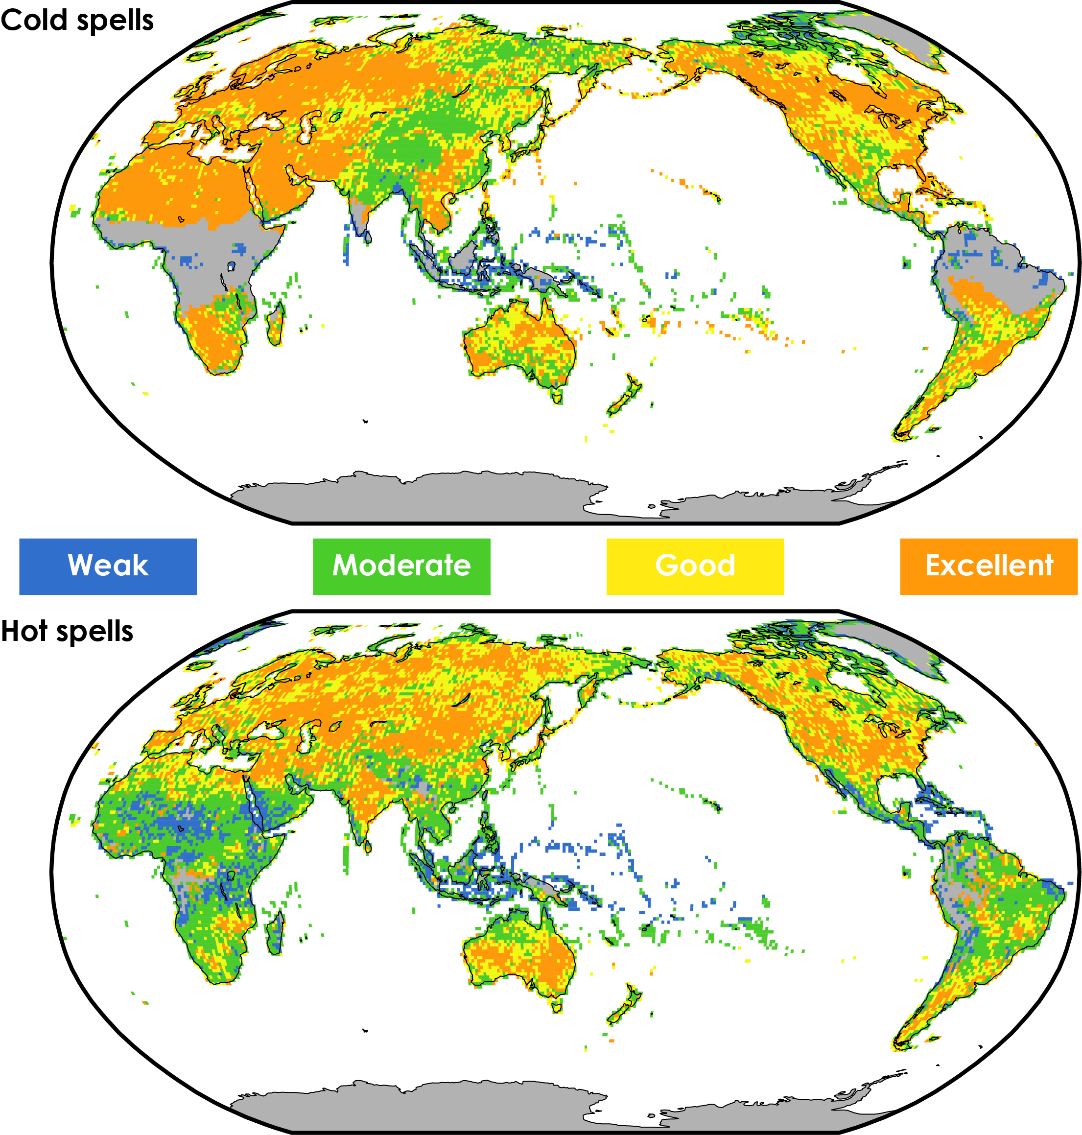
Figure 7.1 How well can we forecast severe heat or cold? Ability to discriminate (see Box 7.2 ) cold (top) and hot (bottom) spells from all other days. The spells are defined as temperatures beyond the 5th and 95th percentiles, respectively, on at least two consecutive days. The forecasts are derived from ECMWF’s ensemble prediction system (see § 7.3.2.4 ), and are verified against the ECMWF analysis (which means that the quality of the forecasts are over-estimated). The score is classified 42 as ‘excellent’ (> 95%), ‘good’ (90 – 95%), ‘moderate’ (67 – 90%), or ‘weak’ (< 67%), and guessing would score 50%. Some areas show no score because of insufficient numbers of spells. (Data source: adapted from Coughlan-Perez et al.)
Simon Mason Madeleine C. Thomson. Chapter 7: Weather Forecasts – Up to One Week in Advance (2019) In “Climate Information for Public Health Action”, Eds. Thomson, M.C. & Mason, S.J. Routledge, London, UK
Notes:
Figure 7.1 How well can we forecast severe heat or cold? Ability to discriminate (see Box 7.2 ) cold (top) and hot (bottom) spells from all other days. The spells are defined as temperatures beyond the 5th and 95th percentiles, respectively, on at least two consecutive days. The forecasts are derived from ECMWF’s ensemble prediction system (see § 7.3.2.4 ), and are verified against the ECMWF analysis (which means that the quality of the forecasts are over-estimated). The score is classified 42 as ‘excellent’ (> 95%), ‘good’ (90 – 95%), ‘moderate’ (67 – 90%), or ‘weak’ (< 67%), and guessing would score 50%. Some areas show no score because of insufficient numbers of spells. (Data source: adapted from Coughlan-Perez et al.)
Simon Mason Madeleine C. Thomson. Chapter 7: Weather Forecasts – Up to One Week in Advance (2019) In “Climate Information for Public Health Action”, Eds. Thomson, M.C. & Mason, S.J. Routledge, London, UK

Slide 32
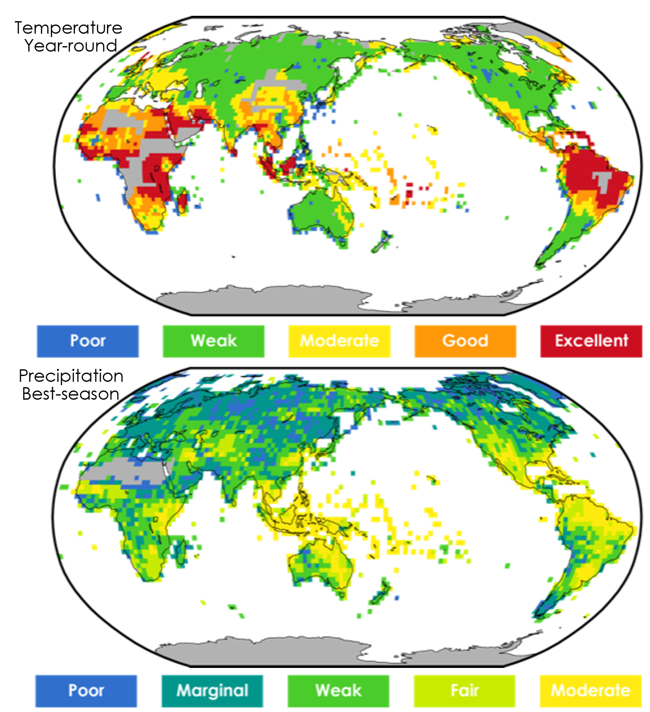
Figure 8.1 A measure of value of IRI’s seasonal (three-month) average temperature (top) and accumulated rainfall (bottom) forecasts for 1997 – 2017. The value is estimated by calculating the percentage return on investments on IRI’s shortest lead-time probabilistic forecasts if paid out with fair odds. For temperature, the value is calculated using forecasts year-round, and the score is classified as ‘excellent’ (> 30%), ‘good’ (20 – 30%), ‘moderate’ (10 – 20%), ‘weak’ (1 – 10%), or ‘poor’ (< 1%). For rainfall, only the value for the highest-scoring season is shown, and the score is classified as ‘moderate’ ( > 10%), ‘fair’ (5 – 10%), ‘weak’ (2.5 – 5%), ‘marginal’ (1 – 2.5%), or ‘poor’ (< 1%). Climatological forecasts would score 0%.
Simon Mason, Chapter 8: Climate Forecasts for Early Warning – Up to Six Months in Advance (2019) In “Climate Information for Public Health Action”, Eds. Thomson, M.C. & Mason, S.J. Routledge, London, UK
Notes:
Figure 8.1 A measure of value of IRI’s seasonal (three-month) average temperature (top) and accumulated rainfall (bottom) forecasts for 1997 – 2017. The value is estimated by calculating the percentage return on investments on IRI’s shortest lead-time probabilistic forecasts if paid out with fair odds. For temperature, the value is calculated using forecasts year-round, and the score is classified as ‘excellent’ (> 30%), ‘good’ (20 – 30%), ‘moderate’ (10 – 20%), ‘weak’ (1 – 10%), or ‘poor’ (< 1%). For rainfall, only the value for the highest-scoring season is shown, and the score is classified as ‘moderate’ ( > 10%), ‘fair’ (5 – 10%), ‘weak’ (2.5 – 5%), ‘marginal’ (1 – 2.5%), or ‘poor’ (< 1%). Climatological forecasts would score 0%.
Simon Mason, Chapter 8: Climate Forecasts for Early Warning – Up to Six Months in Advance (2019) In “Climate Information for Public Health Action”, Eds. Thomson, M.C. & Mason, S.J. Routledge, London, UK

Slide 33
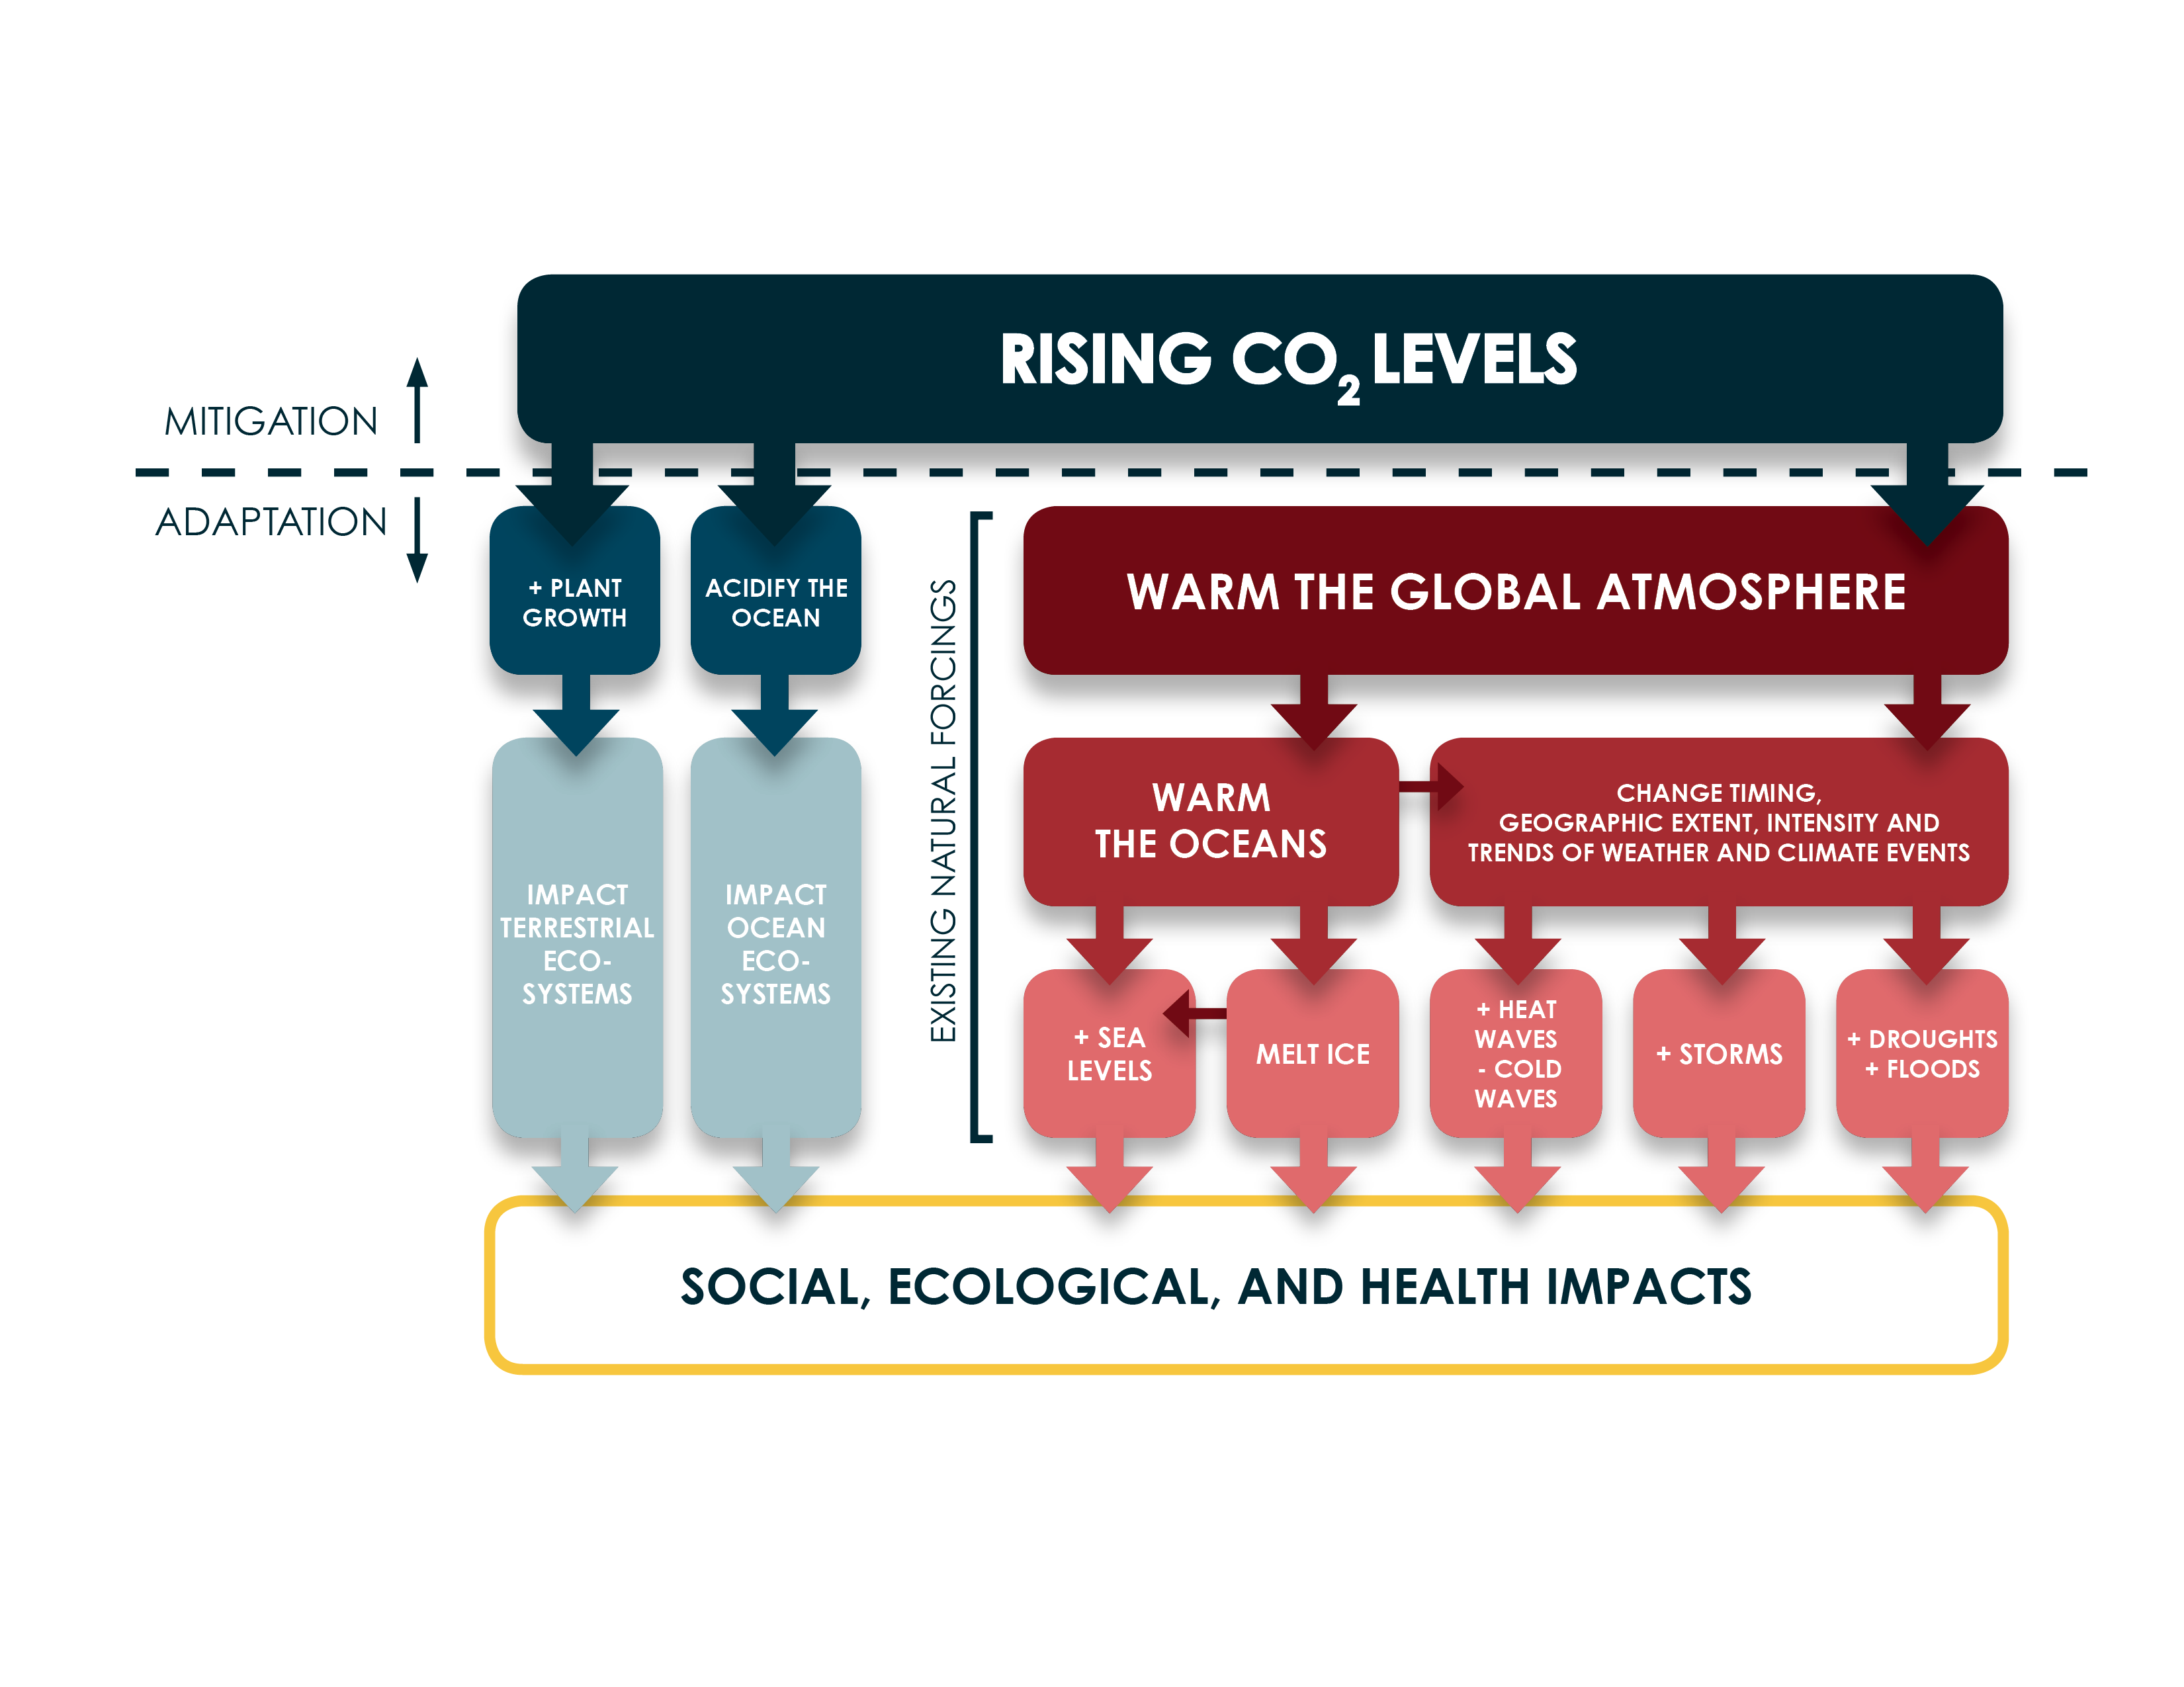
Figure 9.1 Impact pathways of rising CO₂ on social, ecological and health outcomes. Pathways include plant fertilization, ocean acidification and a warming atmosphere. The latter has a direct and indirect (via oceanic warming) impact on our climate. Both atmospheric and ocean warming impact on sea levels through thermal expansion of the seas, destabilization of coastal land ice, and melting of land ice and snow.
Hannah Nissan, Madeleine C. Thomson, Simon J. Mason, Ángel G. Muñoz. Chapter 9: Climate information for adaptation: from years to decades (2019) In “Climate Information for Public Health Action”, Eds. Thomson, M.C. & Mason, S.J. Routledge, London, UK
Notes:
Figure 9.1 Impact pathways of rising CO2 on social, ecological and health outcomes. Pathways include plant fertilization, ocean acidification and a warming atmosphere. The latter has a direct and indirect (via oceanic warming) impact on our climate. Both atmospheric and ocean warming impact on sea levels through thermal expansion of the seas, destabilization of coastal land ice, and melting of land ice and snow.
Hannah Nissan, Madeleine C. Thomson, Simon J. Mason, Ángel G. Muñoz. Chapter 9: Climate information for adaptation: from years to decades (2019) In “Climate Information for Public Health Action”, Eds. Thomson, M.C. & Mason, S.J. Routledge, London, UK

Slide 34
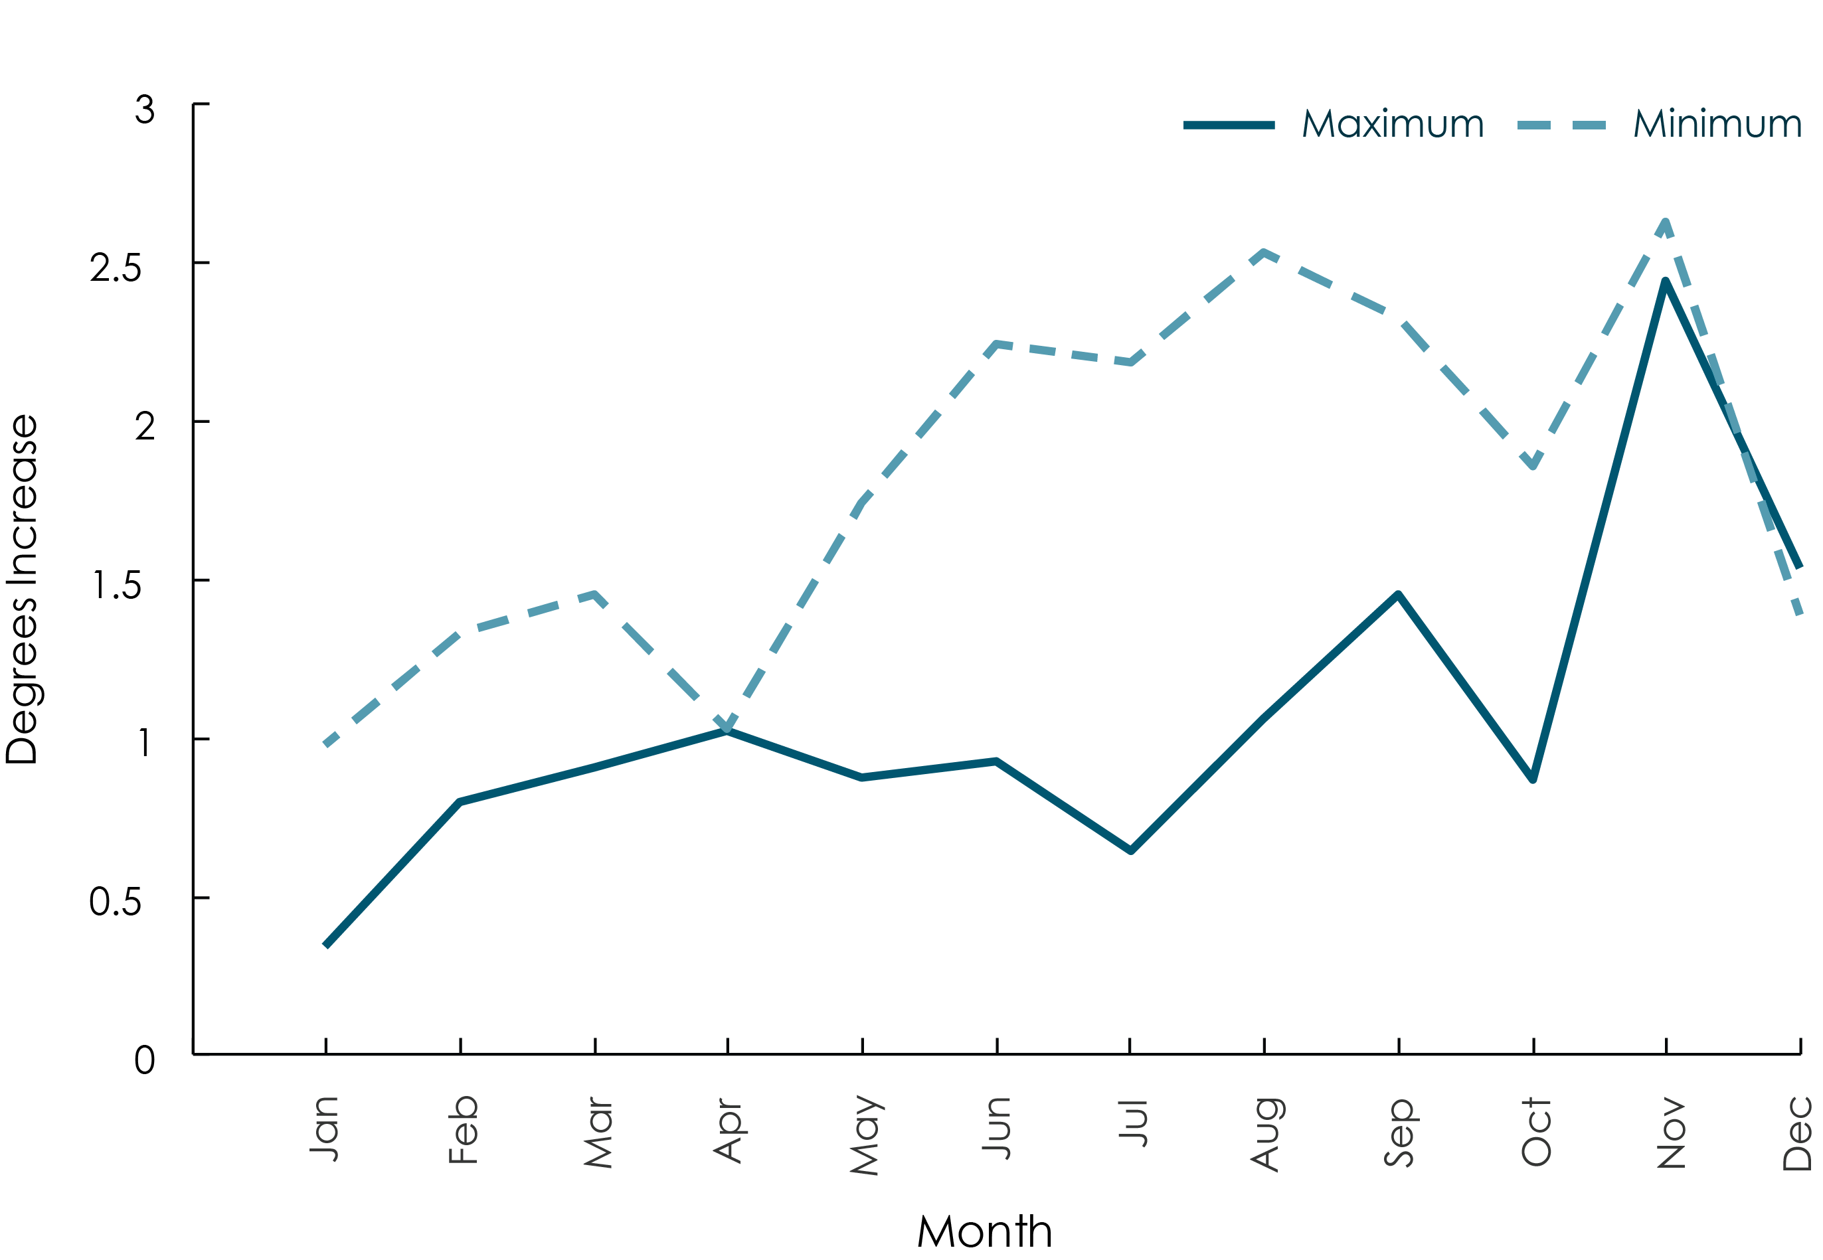
Figure 9.2 Increase in the average minimum and maximum temperatures of each calendar month, from 1960 to 2016, at Rekomitjie Research Station in Zimbabwe. Data from linear regression where the dependent variable was either the mean maximum or mean minimum, in the pertinent month of each year, and the independent variable was the year since 1960. The increases in the minima are significant (P < 0.05) for all months except April. For the maxima the increases are significant only for August, September and November.
Hannah Nissan, Madeleine C. Thomson, Simon J. Mason, Ángel G. Muñoz. Chapter 9: Climate information for adaptation: from years to decades (2019) In “Climate Information for Public Health Action”, Eds. Thomson, M.C. & Mason, S.J. Routledge, London, UK
Notes:
Figure 9.2 Increase in the mean minimum and maximum temperatures of each calendar month, from 1960 to 2016. Data from linear regression. The increases in the minima are significant (P<0.05) for all months except April. For the maxima the increases are significant only for August, September and November.
Hannah Nissan, Madeleine C. Thomson, Simon J. Mason, Ángel G. Muñoz. Chapter 9: Climate information for adaptation: from years to decades (2019) In “Climate Information for Public Health Action”, Eds. Thomson, M.C. & Mason, S.J. Routledge, London, UK

Slide 35
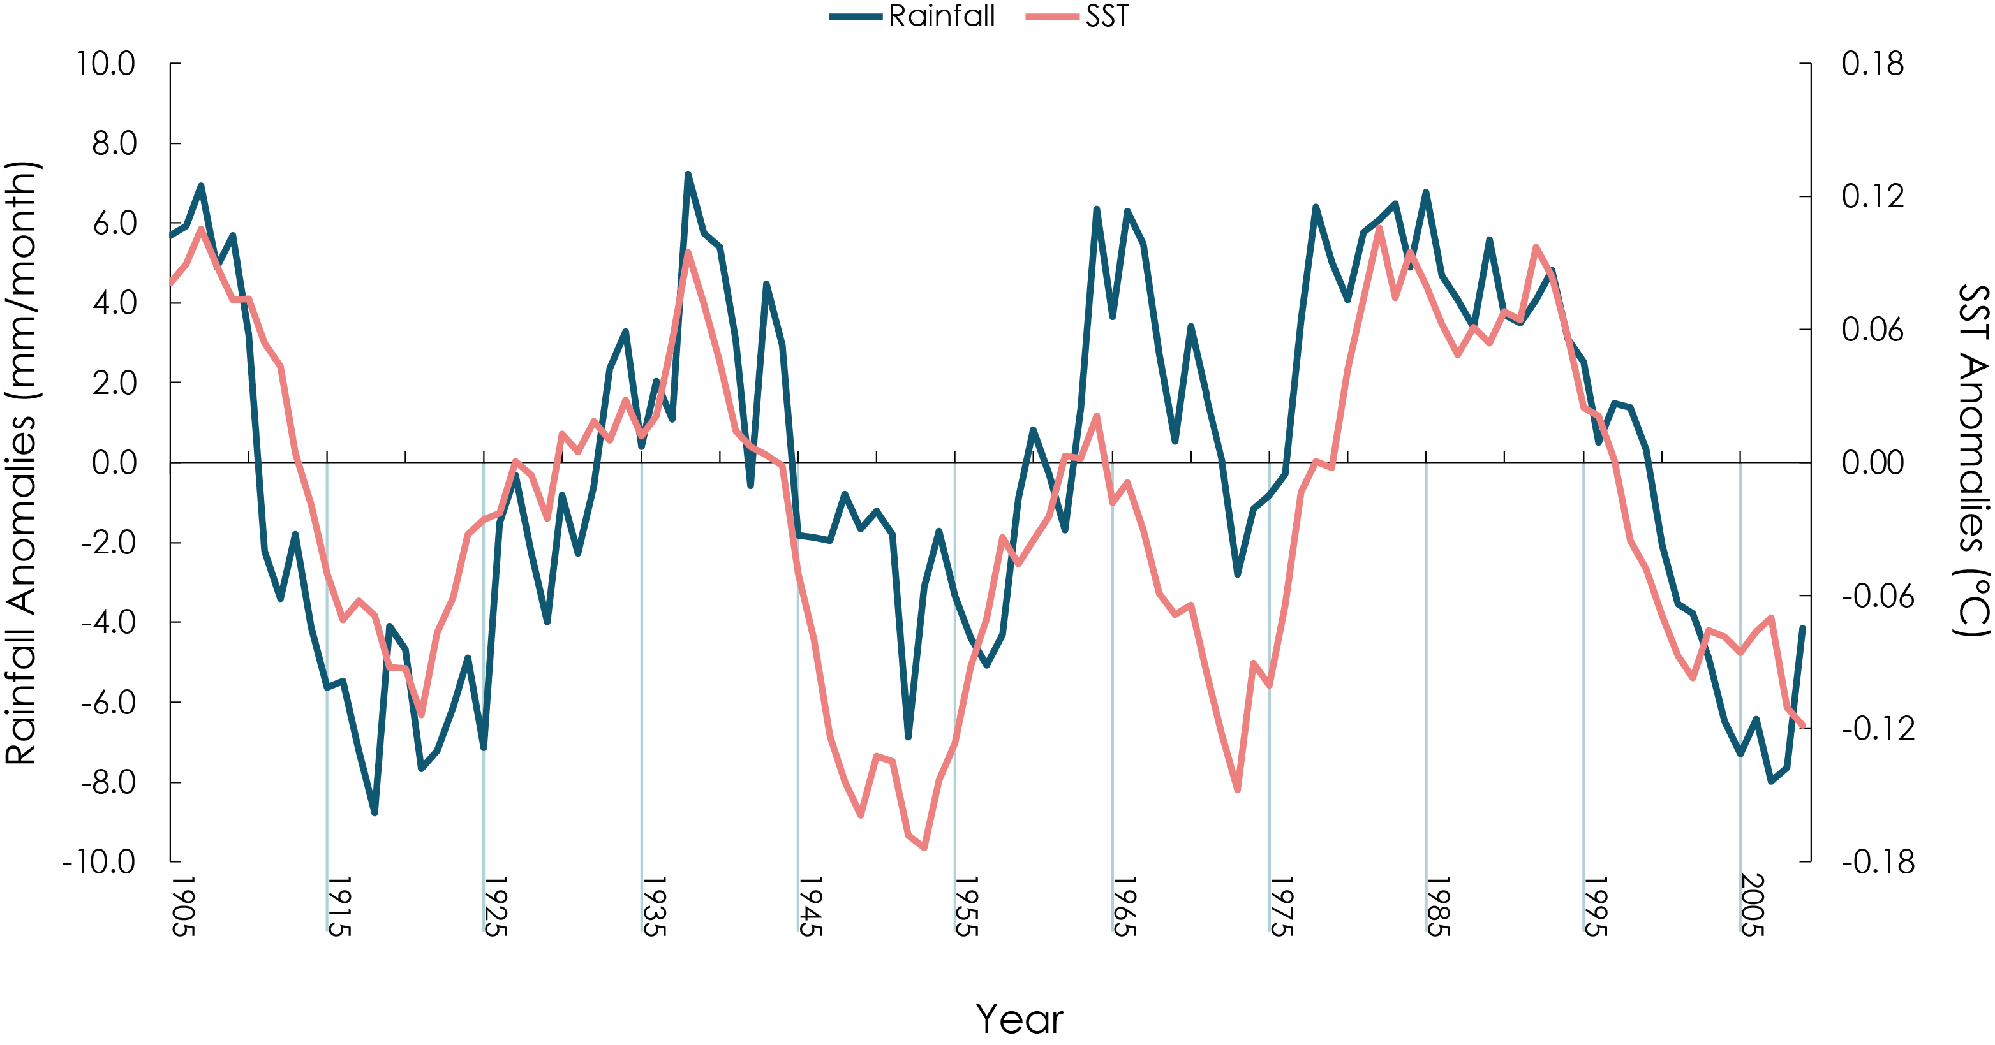
Figure 9.3 Sea-surface temperature anomalies and March–May (MAM) rainfall anomalies in Eastern Africa. Time series of the leading sea-surface temperature mode (anomalies in °C, see left scale) and the detrended East African rainfall anomaly (mm/month, right scale) for MAM. A nine-year moving average has been applied to both series (1905–2008). Adapted from Lyon (2014) and extended in time.
Hannah Nissan, Madeleine C. Thomson, Simon J. Mason, Ángel G. Muñoz. Chapter 9: Climate information for adaptation: from years to decades (2019) In “Climate Information for Public Health Action”, Eds. Thomson, M.C. & Mason, S.J. Routledge, London, UK
Notes:
Figure 9.3 Sea-surface temperature anomalies and March–May (MAM) rainfall anomalies in Eastern Africa. Time series of the leading sea- surface temperature mode (anomalies in °C, see left scale) and the de-trended East African rainfall anomaly (mm/month, right scale) for MAM. A nine-year moving average has been applied to both series (1905–2008). Adapted from Lyon (2014) and extended in time.
Hannah Nissan, Madeleine C. Thomson, Simon J. Mason, Ángel G. Muñoz. Chapter 9: Climate information for adaptation: from years to decades (2019) In “Climate Information for Public Health Action”, Eds. Thomson, M.C. & Mason, S.J. Routledge, London, UK

Slide 36
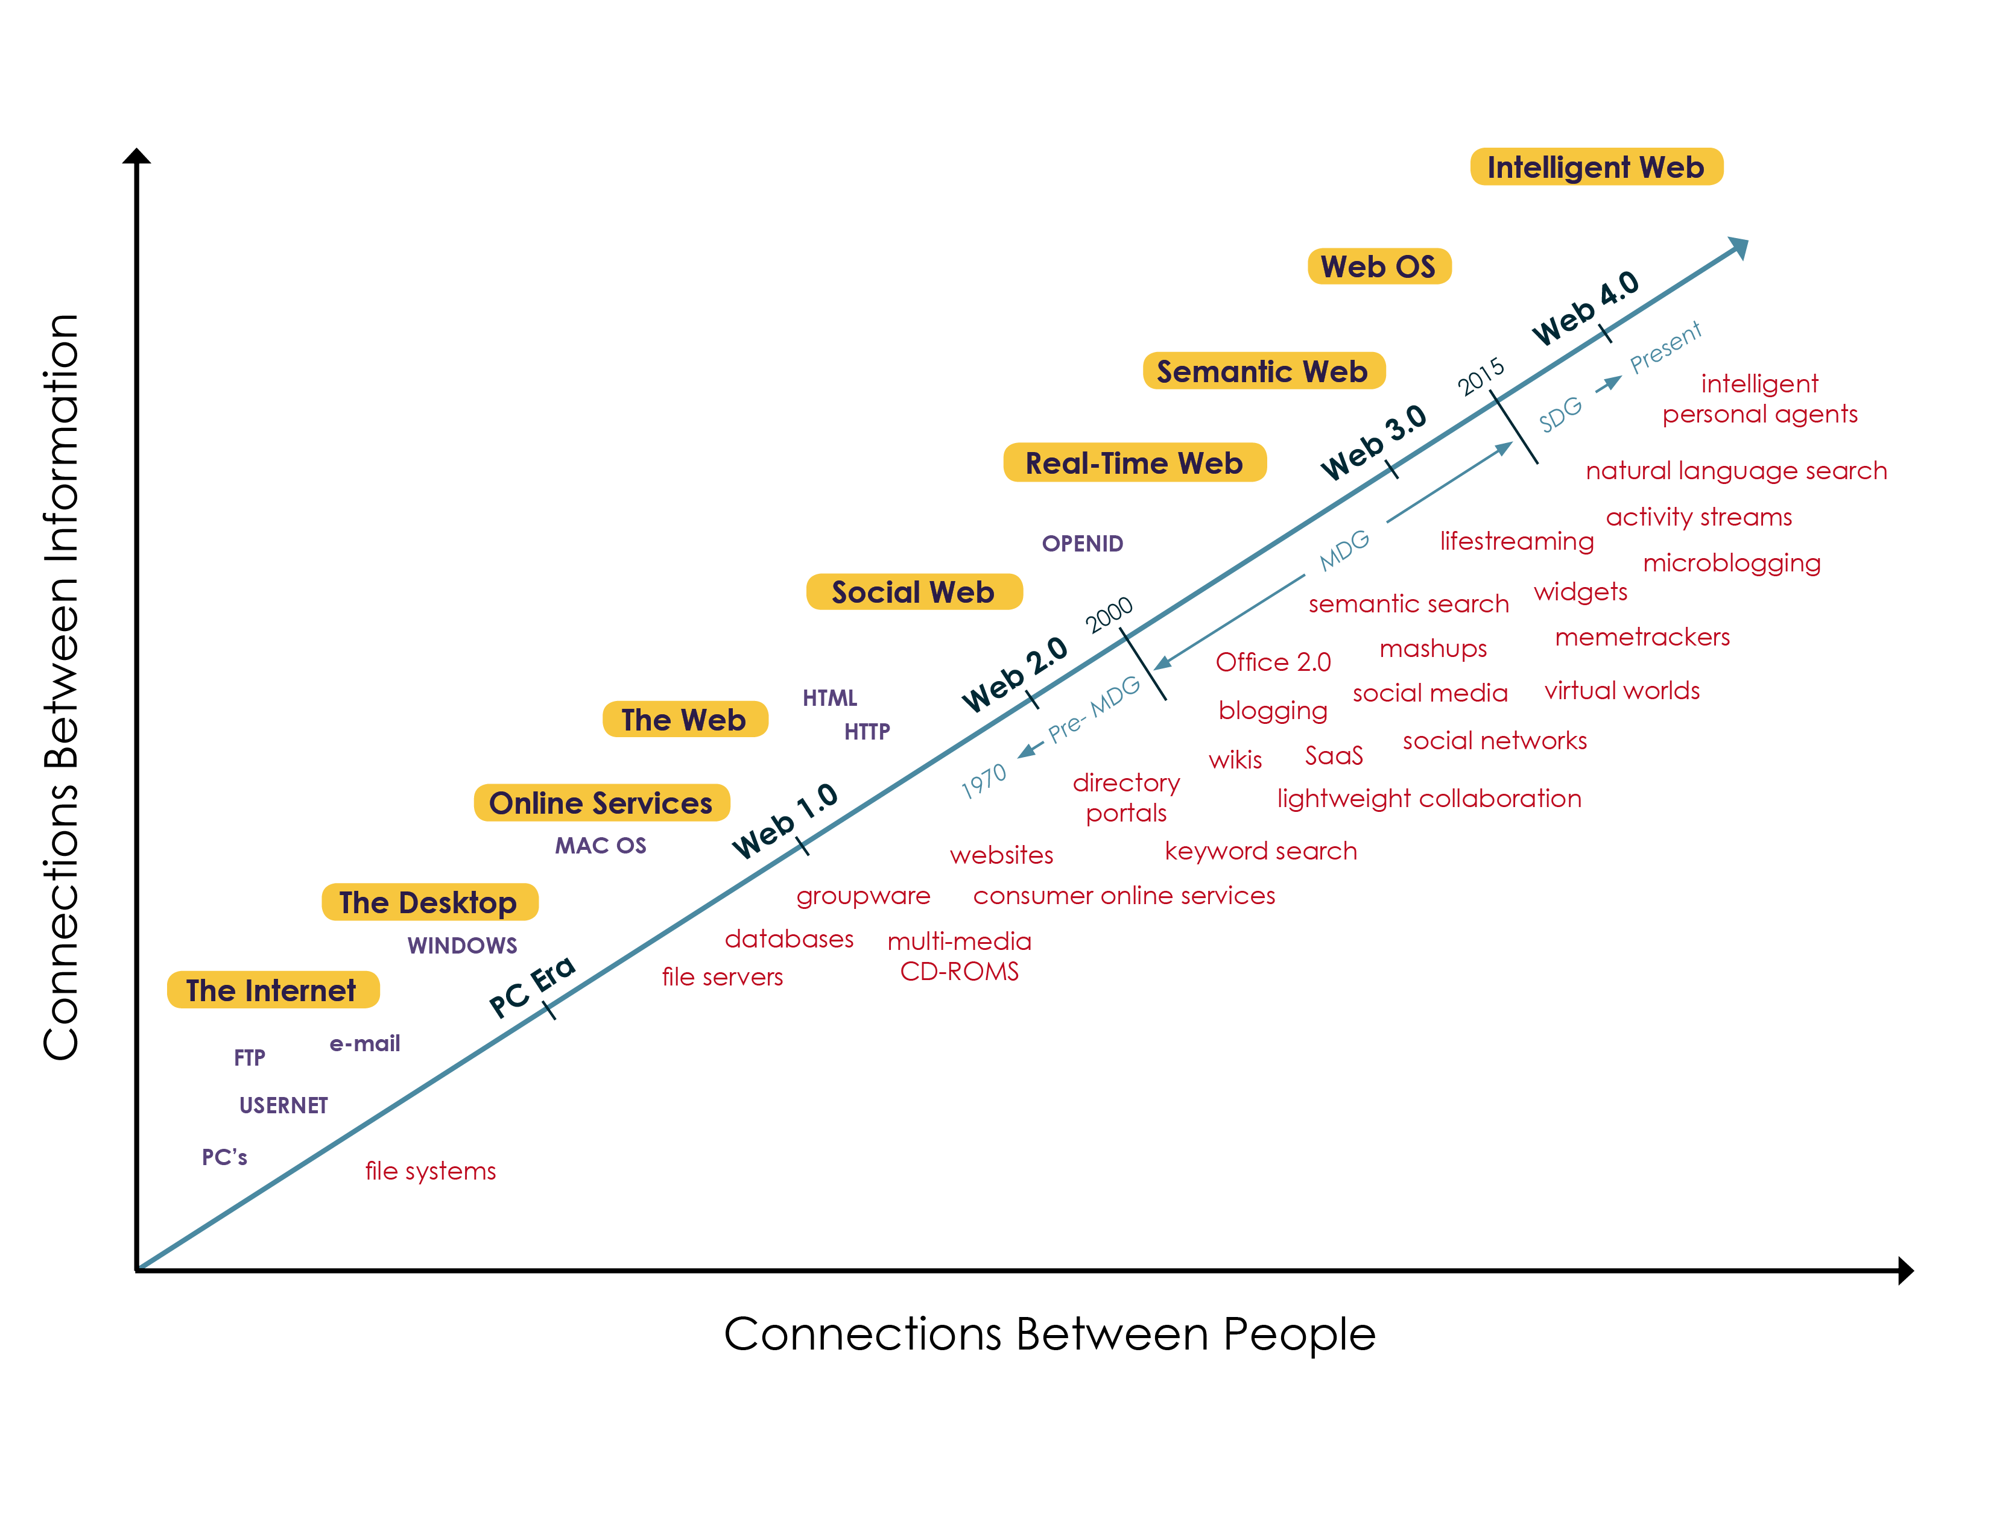
Figure 10.1 Connecting information and people. Image adapted with permission from “the intelligence is in the connections” created by Nova Spivack www.novaspivack.com
Madeleine Thomson Simon Mason, Chapter 10: Climate Information for Public Health Action: challenges and opportunities (2019) In “Climate Information for Public Health Action”, Eds. Thomson, M.C. & Mason, S.J. Routledge, London, UK
Notes:
Figure 10.1 Connecting information and people. Image adapted with permission from “the intelligence is in the connections” created by Nova Spivack www.novaspivack.com
Madeleine Thomson Simon Mason, Chapter 10: Climate Information for Public Health Action: challenges and opportunities (2019) In “Climate Information for Public Health Action”, Eds. Thomson, M.C. & Mason, S.J. Routledge, London, UK

Slide 37
Figure 10.2 Research findings can better inform decision-making if they take into account the different perspectives that influence decision-making
Madeleine Thomson Simon Mason, Chapter 10: Climate Information for Public Health Action: challenges and opportunities (2019) In “Climate Information for Public Health Action”, Eds. Thomson, M.C. & Mason, S.J. Routledge, London, UK
Notes:
Figure 10.2 Research findings can better inform decision-making if they take into account the different perspectives that influence decision-making
Madeleine Thomson Simon Mason, Chapter 10: Climate Information for Public Health Action: challenges and opportunities (2019) In “Climate Information for Public Health Action”, Eds. Thomson, M.C. & Mason, S.J. Routledge, London, UK

